Slide 1
Materials for Syringe Services Programs A Guide for Staff & Volunteers
Name(s) Here
Job Title(s) Here

Slide 2
LEARNING OBJECTIVES
Identify the safer injection materials that syringe services programs (SSPs) can offer.
Understand the role of each type of material in the prevention of viral hepatitis, HIV, viral endocarditis, and other skin and soft tissue infections.
Explain to a program participant about how to use each material and what its purpose is.
Counsel participants with a “best, good, please avoid” framework that helps focus limited resources on what materials to provide or recommend.

Slide 3
Purpose
This learning tool was designed for health departments and community-based organizations newly offering syringe services programs (SSPs) with the purpose of indexing the materials needed for safer injection, what to offer at a syringe services program, and how to explain what materials are offered to participants in that program.
The learning tool consists of a PowerPoint slide deck that SSPs and health departments can customize for their in-house staff and volunteer trainings, a presenter’s guide, and a double-sided informational flyer for easy distribution to staff and participants of SSPs.

Slide 4
Table of Contents
Messaging
Explain to a program participant about how to use each material and what its purpose is.
About
The role of each type of material in the prevention of viral hepatitis, HIV, viral endocarditis, and other skin and soft tissue infections.
Messaging
Counsel participants with a “best, ok, please avoid” framework
Sections
Slide types
Syringes
Waste disposal
Materials used before, during, and after drug preparation
Addendum
About
The role of each type of material in the prevention of viral hepatitis, HIV, viral endocarditis, and other skin and soft tissue infections.
Messaging
Explain to a program participant about how to use each material and what its purpose is.
Counsel participants with a “best, ok, please avoid” framework
Notes:
The contents are split into four parts. The first section on syringes covers information about syringe types and needle lengths, gauges, and volumes of syringes separately, then combines all of these components into the specific syringes offered to participants at an SSP. The section on syringes also discusses informational resources about injection that can be handed out. The second section discusses waste disposal and tools to help participants more safely store and discard used syringes. The third section covers a wide variety of tools that are helpful before, during, and after drug preparation. In the final section, an addendum, additional resources for other routes of drug administration are covered. For every item discussed in the above discussions, there are two slide types. The first slide introduces the role of each type of material in the prevention of viral hepatitis, HIV, viral endocarditis, and other skin and soft tissue infections. The second slide teaches how to explain to a program participant about how to use each material and what its purpose is and how to counsel participants with a “best, good, please avoid” framework.

Slide 5
Section One: Syringes

Slide 6
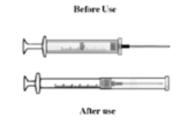
Syringes: Type
Retractable or single use syringes
Appropriate for use in healthcare settings but discouraged for SSPs
Two-piece detachable needle or luer lock syringe
Drug preparation while the needle is detached saves the needle from potential dulling and allows a needle to be replaced if it clogs
One piece or integral cannula – type
Most common, known as an “insulin syringe”
Retains substantially less blood and drug after IV use
Retractable or single use syringes
Two-piece detachable needle or luer lock syringe
One piece or integral cannula - type
Appropriate for use in healthcare settings but discouraged for SSPs
Drug preparation while the needle is detached saves the needle from potential dulling and allows a needle to be replaced if it clogs
Most common, known as an “insulin syringe”
Retains substantially less blood and drug after IV use
Notes:
Retractable syringes – syringes that are designed to be single-use only, primarily created to reduce the chance of accidental needlesticks in healthcare settings. The use of this type of syringes are discouraged for SSP distribution due to being less preferred by most people who inject drugs and come with higher risk of overdose.
Retractable syringes are discouraged in part because they are incompatible with “booting” – an injection practice whereby a person repeatedly plunges and adjusts the volume of substance in a syringe more than once during a single injection episode. Booting has been shown to be preventive against accidental overdose and can create a more prolonged and pleasurable drug effect. Booting is not possible with retractable syringes which are not recommended for distribution within SSPs.
2 piece or detachable needle type or luer lock syringe
these are more commonly seen for intramuscular injection sizes but are also available in IV needle sizes
since this needle type has dead space, which can store trace amounts of blood and drug solution, it is not as highly recommended for SSPs
Drug preparation while the needle is detached saves the needle from potential dulling and allows a needle to be replaced if it clogs
1 piece or integral cannula type – more common
Most common, known as an “insulin syringe”
retains substantially less blood and drug after IV use
not really just 1 piece because the plunger can be removed from the back and allows for booting
SOURCES:
Zule WA, Bobashev G. High dead-space syringes and the risk of HIV and HCV infection among injecting drug users. Drug Alcohol Depend. 2009;100(3):204-213. doi:10.1016/j.drugalcdep.2008.08.017
Elijah Paintsil, Huijie He, Christopher Peters, Brett D. Lindenbach, Robert Heimer, Survival of Hepatitis C Virus in Syringes: Implication for Transmission among Injection Drug Users, The Journal of Infectious Diseases, Volume 202, Issue 7, 1 October 2010, Pages 984–990, https://doi.org/10.1086/656212
Gyarmathy VA, Neaigus A, Mitchell MM, Ujhelyi E. The association of syringe type and syringe cleaning with HCV infection among IDUs in Budapest, Hungary. Drug Alcohol Depend. 2009;100(3):240-247. doi:10.1016/j.drugalcdep.2008.10.014
Zule WA, Desmond DP, Neff JA. Syringe type and drug injector risk for HIV infection: a case study in Texas. Soc Sci Med. 2002;55(7):1103-1113. doi:10.1016/s0277-9536(01)00256-8

Slide 7
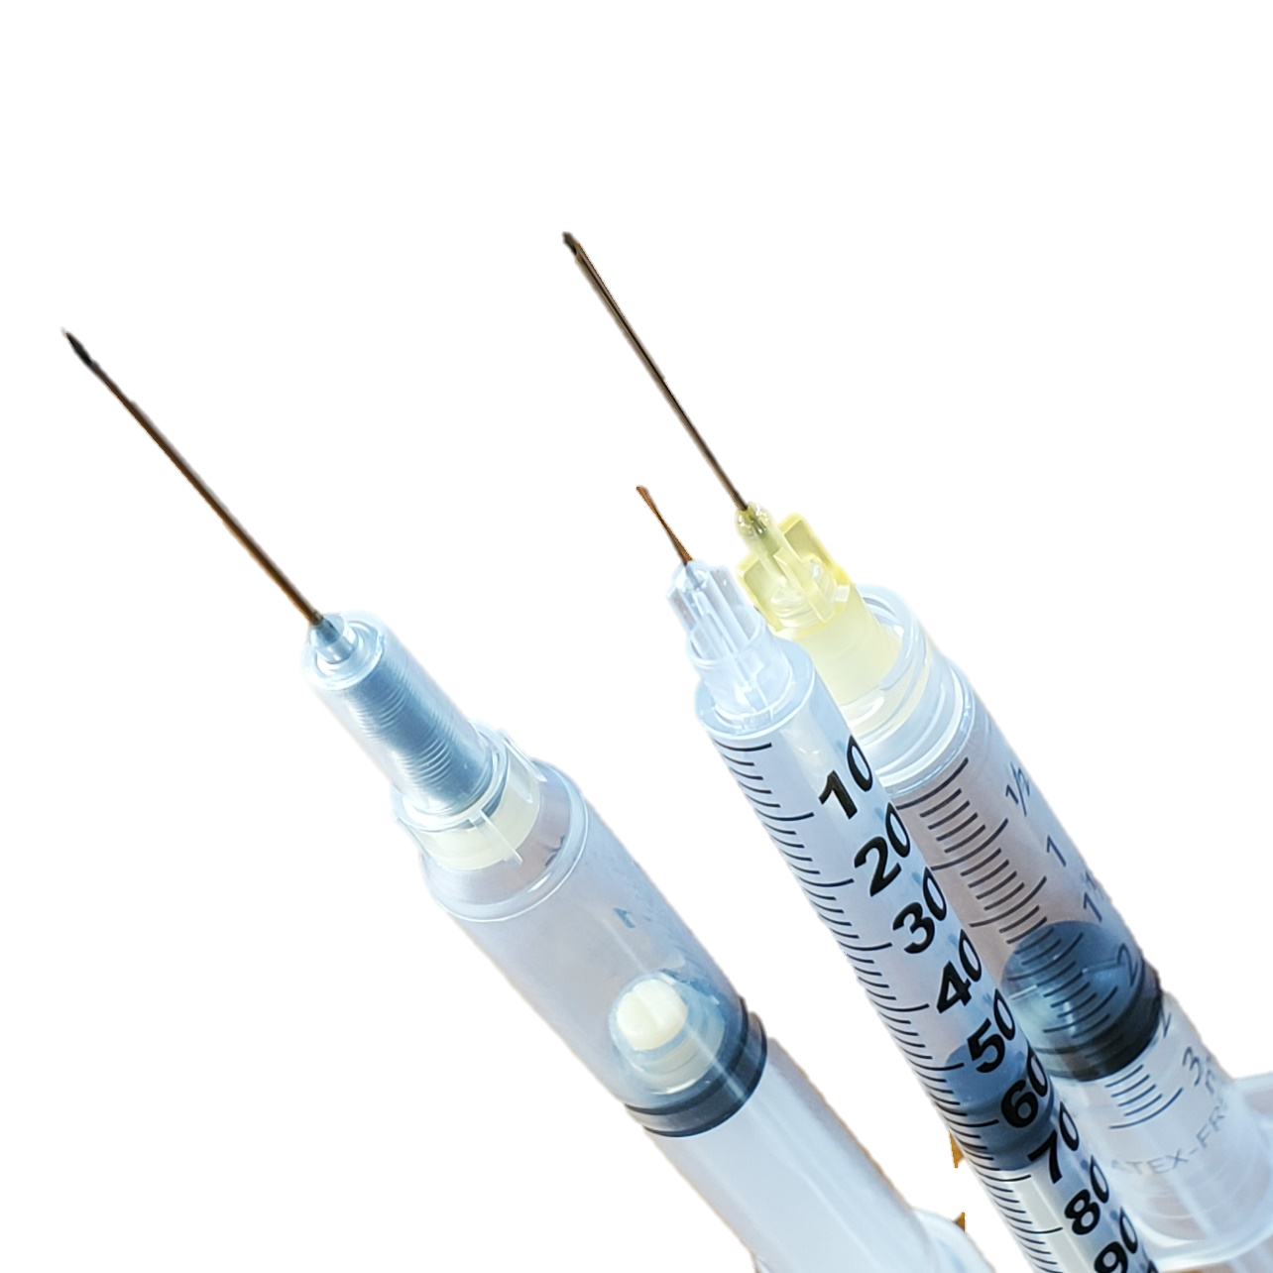
Syringes: Type
Sterile, unused one piece or integral cannula type
Sterile, unused two piece or detachable needle type
Retractable syringes and previously used syringes of any type
“What type do you prefer?”
Notes:
Participants like what type of syringe they are used to using and feel capable using. Offer the type your participants prefer and provide resources and support so participants can try new tools that will support their health, if self motivated to do so.

Slide 8
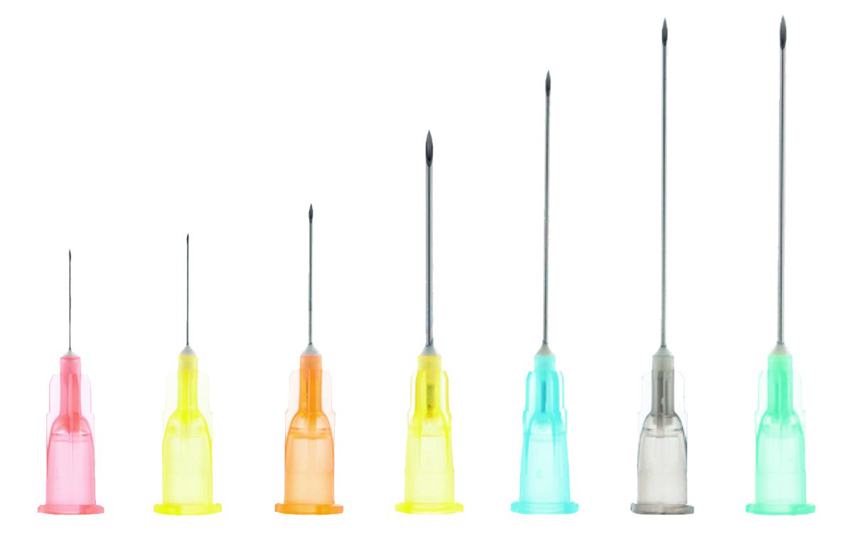
Syringes: Length
Intravenous
½ inch = 12.7 mm
5/16 inch = 8 mm
Less commonly, ⅝ inch needles
Intramuscular
1 ½ inches
Learn what language is used in your communities
short or long tips
Notes:
The shorter needle, the less chance of clogging. However, needle length must reach the depth of the vein being injected into. It is less common for participants to need ⅝ inch syringes, because few inject into veins that deep.
Cultural norms or accepted styles or methods, including terminology and slangs vary from community to community, it’s important to learn what the norms are for the community being served by an SSP in order to best meet the needs of the participants. For example, if someone requests some short and some long tips, what does that mean in your region? In your community, are ½ inch syringes are known as “longs” while 5/16 inch are “shorts?” In New Orleans yes, in New York City, no. Context clues help with determining the appropriate length. In particular the available needle lengths from a manufacturer will differ with the needle’s gauge size.

Slide 9
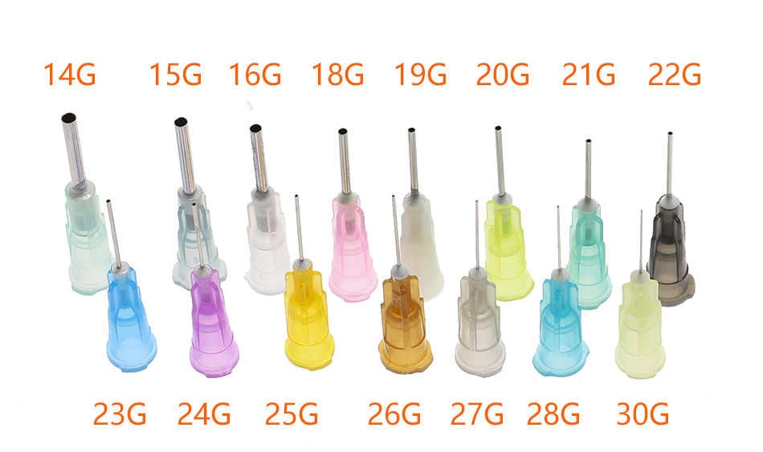
Syringes: Gauge
Gauge is the circumference (size around) of a needle point
Differs according to:
Viscosity or “thickness” of blood and fluid being injected
The size circumference (around of) the vein
Common IV sizes are 27g, 28g, 29g, 30g, and 31g
Common intramuscular are 18g, 20g, 22g

Slide 10
Syringes: Gauge
 | Small |  |  |  |  |  |  | Large
Gauge | 31 | 30 | 29 | 28 | 27 | 25 | 22 | 18
Injection sites | ← Intravenous (IV) →
 |  |  |  |  |  | ← Intramuscular →
Viscosity | Thin |  |  |  |  |  |  | Thick
Needle strength | Weak |  |  |  |  |  |  | Strong
Pain & bruising | Low |  |  |  |  |  |  | High
Notes:
Smaller sizes have bigger numbers, large sizes have smaller numbers. As in the sizing of piercings or tools.
Blood will be less viscous when a person is well hydrated. Drug preparations can differ in viscosity based on the amount of water or saline mixed with the drug and the type of drug.
The needle gauge should match the size around of the vein. Veins in the hands are smaller than in the arms, so gauge would be a higher number, like a 30g in the hand, and a 27g in a vein near the elbow. Femoral vein, use 25g or higher, longer tips too (at least 1 inch)
Also, different people may have smaller or larger veins. There is no one size fits all.
Smaller gauges tend to be less painful and do less damage to veins. Conversely, larger gauges clog less easily and are more durable.

Slide 11
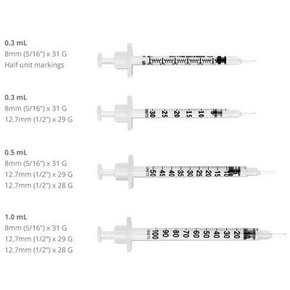
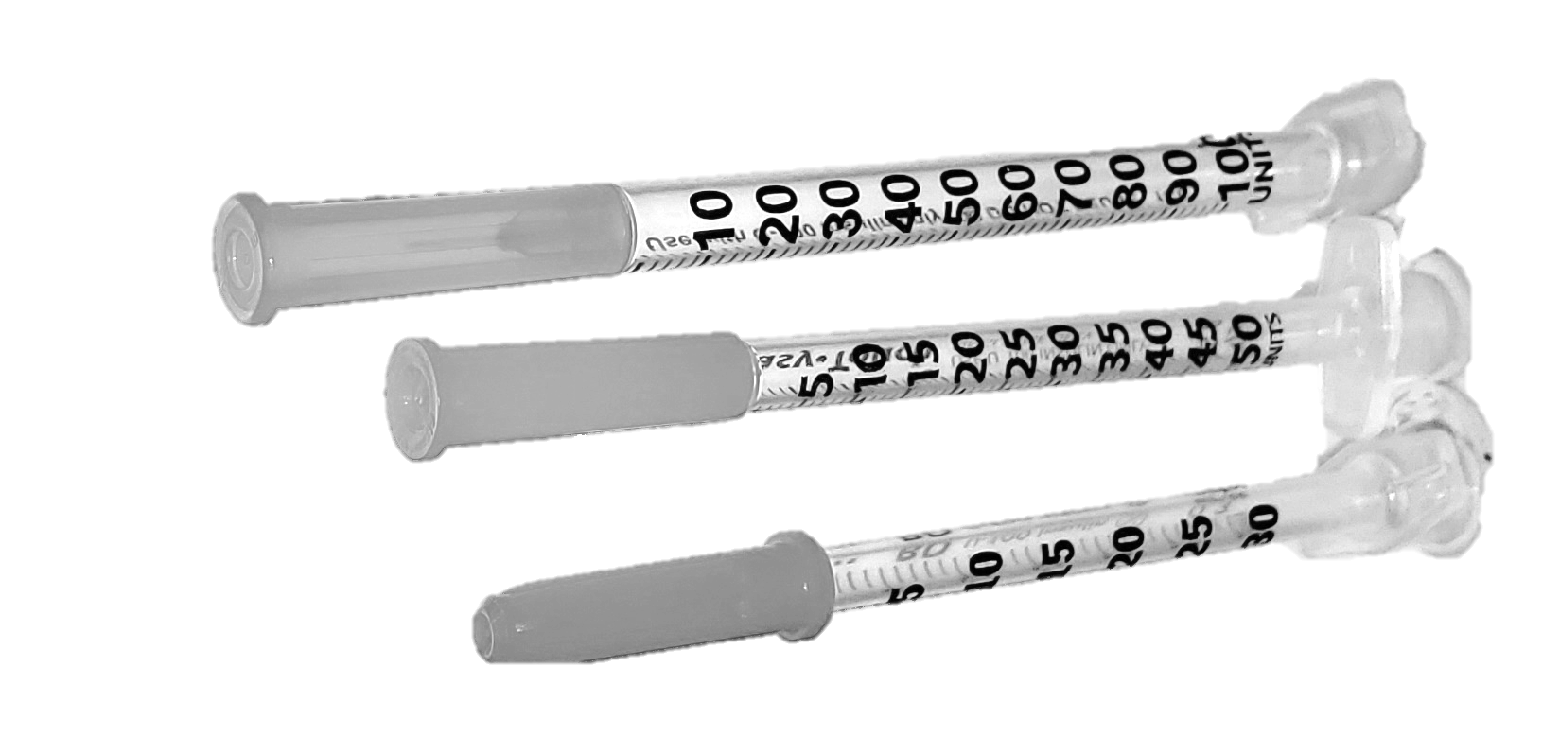
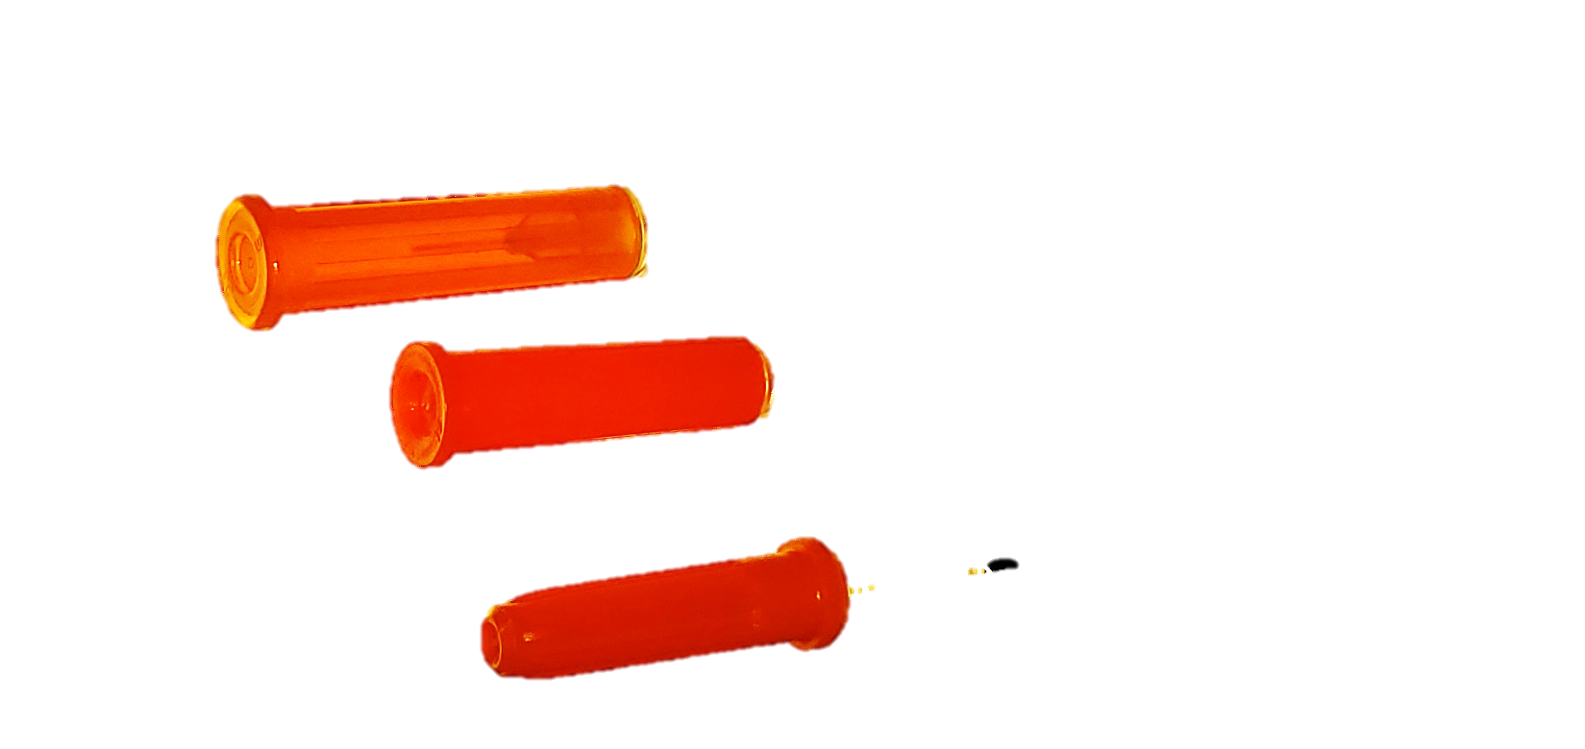
Syringes: Volume
The volume of fluid that can be held in a syringe barrel
Marked by graduations on the size of the barrel
Range from 1/3 mL to 3 mL
Notes:
1 cubic centimeter (cc) = 1 milliliter (mL)
⅓ mL is seen typically in insulin injections, SSPs more frequently offer ½ mL or 1 mL. 1 mL is the most common volume. Greater than 1 mL barrels are more common with 2 piece syringes or syringes designed for intramuscular injection.
A smaller volume may increase the number of times someone injects, and the higher the number of injections increases potential vein damage and infection. More injections of smaller amounts, conversely, can be helpful in reducing overdose risk.
Syringe volume may also depend on what drug is being injected: smaller, finer syringes are preferred for fentanyls/opioids, while a larger barrel size may be needed for pills and other drugs that require more water to mix.

Slide 12
Syringes: Size Summary
How do the length, gauge, and volumes fit together?
Stock lower quantities of
31g 5/16 inch 1mL, 30g ½ inch 1mL, any 31-27g in 0.5mL, 27g 5/8 inch 1mL, 18g-25g 1 ½ inch 3 mL
Stock higher quantities of
30g 5/16 inch 1mL, 29g ½ inch 1mL, 28g ½ inch 1mL, and 27g ½ inch 1mL
Notes:
Smaller gauges are usually manufactured with smaller needle sizes, because the smaller a vein is the closer it is to the surface of the skin. For example, a 31g syringe will only be manufactured in a 5/16 inch length or smaller. Whereas, a 30g syringe (one size larger around) may be manufactured in ½ inch or 5/16 inch. A ⅝ inch syringe will come in a gauge that is 27g or larger. Syringe volumes are generally 1 ml or ½ mL for the gauges between 27g and 31g and will be larger in larger gauges (a number less than 27) or smaller in smaller gauges.
Sometimes participants are unclear about what sizes work best for them. Offer an assortment.
Be creative about how you display what sizes are in stock. Showing pictures will help participants identify the packaging they know and are used to.
Do not allow participants to touch sample needle points, this could lead to needlesticks.

Slide 13
Syringes: Size Summary
Continue the injection practice that is most comfortable and reliable, using the appropriate syringe size
Changing to inappropriate and ineffective syringe sizes that cause an increase in the amount of injections
Use as small a needle gauge as possible
smaller hole = smaller wound = reduced healing time
No one size fits all
For example
A participant asks for 29g 5/16” 1cc syringes
For sizes, I have either 29g ½” or 30g 5/16”. Do you want some of each size?
Participant says, “Actually not the short ones (1/2”) I prefer the 30 5/16”
I want to clear up information about the sizes: 5/16” is shorter than ½”. If it helps, the 29g ½” have a green label and the 30g 5/16” have a blue label. Here’s a picture of needle lengths to help make this clear.
I want the 29g ½” if that’s the long needle.
Notes:
Help the program participant understand that everyone is different and there’s no one size fits all. Offer support and resources so participants access the right tools for them.
Depending on the context of injection, the participant may be able to make changes to their injection practice that improve health. With increased knowledge about injection sites and their corresponding syringe sizes, participants may be able to engage in better vein care.
However, a participant’s own injection practice offers reliability and comfort, and it may not be appropriate to recommend a change. While some participants can use smaller less painful syringes that do less damage to veins, others may prefer the larger gauge needles because they do not clog as easily, and they can penetrate thick scar tissue without bending. A larger gauge size may be preferred by participants who have inadequate syringe access and want a more durable syringe for reuse.
Changes to inappropriate or ineffective syringe sizes may increase the risk of losing the vein and missing the injection (accidentally moving the tip of the needle out of the vein and injecting some of the solution into tissue), which results in bruising and possible abscess. When programs distribute “safety” syringes, like retractable syringes or syringes with safety arms attached to them, some participants experience frustration that results in injury when trying to inject. If programs do not distribute enough syringes for the need, then participants may request more durable, larger gauge syringes for reuse.
A note on volume: smaller volume syringes may increase the number of injections per day but also help reduce overdose risk, by decreasing the amount of drug consumed at one time. Syringe volume may also depend on what drug is being injected: smaller, finer syringes are preferred for fentanyls/opioids, while a larger barrel size may be needed for pills and other drugs that require more water to mix.
SOURCES:
Zule WA, Desmond DP, Neff JA. Syringe type and drug injector risk for HIV infection: a case study in Texas. Soc Sci Med. 2002;55(7):1103-1113. doi:10.1016/s0277-9536(01)00256-8

Slide 14
Please pack me 29g 5/16” 1cc syringes?
For sizes, I have either 29g 1/2” or 30g 5/16”
Want some of each size?
Actually not the short ones (1/2”) I prefer the 30 5/16”
I want to clear up information about the sizes: 5/16” is shorter than 1/2”… If it helps, the 29g 1/2” have a green label and the 30g 5/16” have a blue label
I want the 29g 1/2“ if that’s the long needle
Notes:
Example conversation about sizes:
A participant asks for 29g 5/16” 1cc syringes
For sizes, I have either 29g ½” or 30g 5/16”. Do you want some of each size?
Participant says, “Actually not the short ones (1/2”) I prefer the 30 5/16”
I want to clear up information about the sizes: 5/16” is shorter than ½”. If it helps, the 29g ½” have a green label and the 30g 5/16” have a blue label. Here’s a picture of needle lengths to help make this clear.
I want the 29g ½” if that’s the long needle.

Slide 15
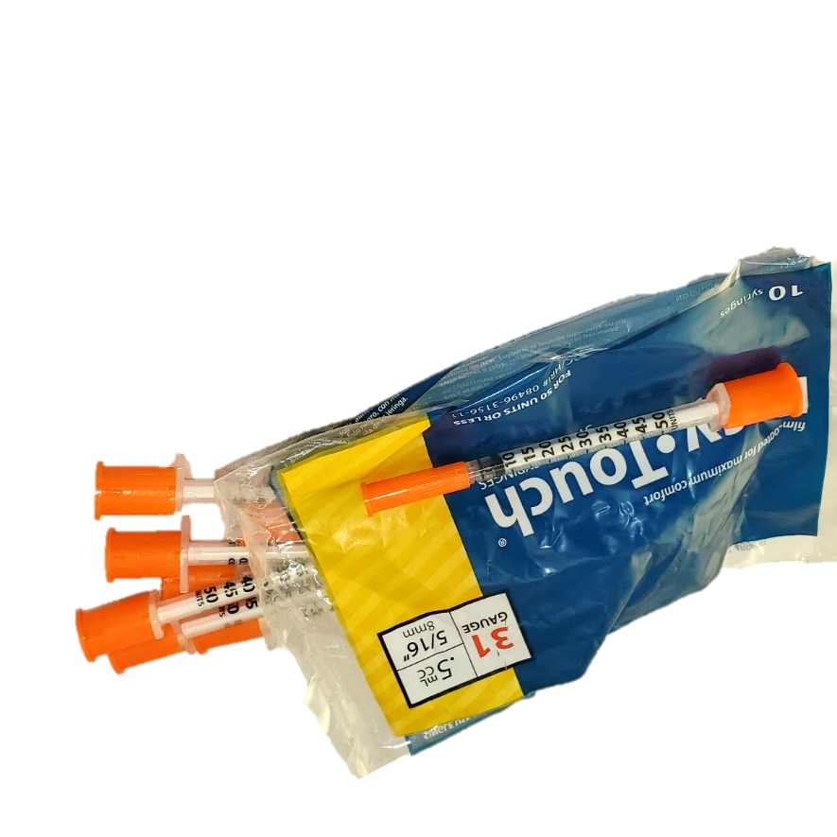
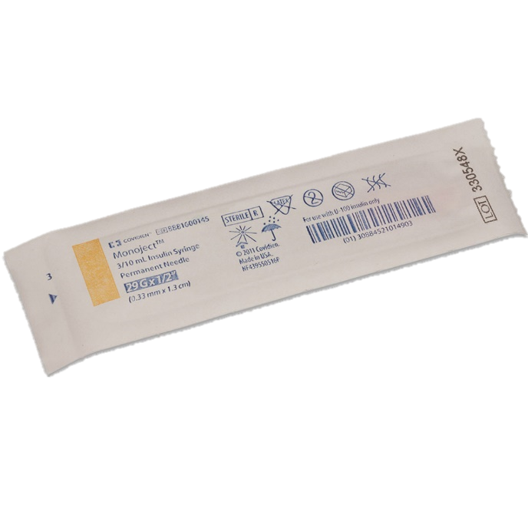
Syringes: Quantity
Offerings may be needs based (best practice) or exchanged one for one
Packaged in boxes of 100 syringes, cases of 5 boxes (or 500 syringes)
Packaged in bags of 10 or individually wrapped
Notes:
Benefit of individually wrapped syringes is better assurance of whether the syringe is sterile. The cons include increased non-recyclable waste and sometimes higher costs or lower availability.
The syringes offered to participants will be a balance between local ordinances and participant need.
1:1 exchange – a practice of restricting syringe access by providing a participant only the number of syringes that the participant returns to the SSP for disposal (not a recommended practice – see needs-based distribution).
Needs-based distribution – a syringe distribution practice that allows participants as many syringes as they say they need, regardless of how many syringes they return to the SSP for disposal. A best practice.
Secondary syringe exchange – a practice through which SSP participants distribute sterile syringes and injection equipment to peers within their social and drug-using networks who cannot or will not attend SSPs; often secondary exchangers also collect used syringes for safe disposal.
Best practice is needs-based distribution.

Slide 16
Syringes: Quantity
Request a quantity that is enough of everything new for every injection, for you and for the people you use with
Bleach and rinse, if sharing or reuse is unavoidable
Share or reuse needle with persons with known HIV or hepatitis infection. Share with people whose status is known or who are trusted.
[Include your program policies here]
Notes:
Encourage secondary syringe access. Let participants know SSP staff consider them partners in protecting a shared community and participants are valued for their efforts in accessing the communities the SSP does not reach.
Offer needs-based quantities. Give enough syringes so they are not reused. Repeated use of the same needle dulls the needle and harms veins, which may increase likelihood of abscess or other infections.
If quantities are too large for the program to provide, reassure participants about timeframe. For example, “request what you need for this week, then next week, we’ll be sure to get you the quantity we missed this time.”
If a program cannot provide secondary and/or needs based syringe access, then let participants know about the relative risks of sharing, reusing, and bleaching their equipment. According to a study, most of the bacterial infections in people who inject drugs were a result of use of used needles and “booting” (flushing and pulling back during injecting), which may increase risk of abscess formation.
A number of other factors have been linked to soft tissue infection and infection in other parts of the body including:
Use of syringe-mediated sharing of prepared drugs, as in syringe sharing and/or front- or back-loading
Needle licking increases risk for infection with their commensal flora (symbiotic, “good” bacteria of the mouth and throat that may cause harm in the veins and circulation)
Housing status - housing status is an important determinant of injection practices
Femoral, and jugular injections are much riskier than other injection sites
Bleaching is the most effective disinfectant (as compared to rubbing alcohol, water, and other cleaning liquids) and rinsing efficacy is increased with a second rinse. Directions for best practice is available from the CDC (https://www.cdc.gov/hiv/pdf/library/factsheets/cdc-hiv-clean-your-syringes.pdf).
PROs: Bleach disinfection of syringes may help to prevent HIV and HCV infection
CONs: Bleach may enhance tissue inflammation and increase transmission of infections

Slide 17
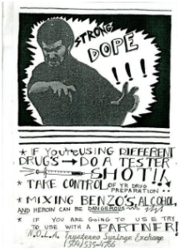
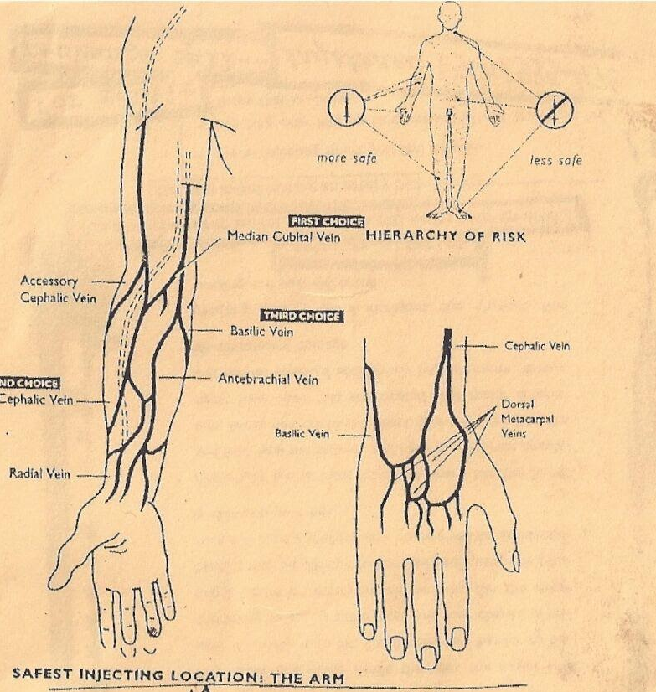
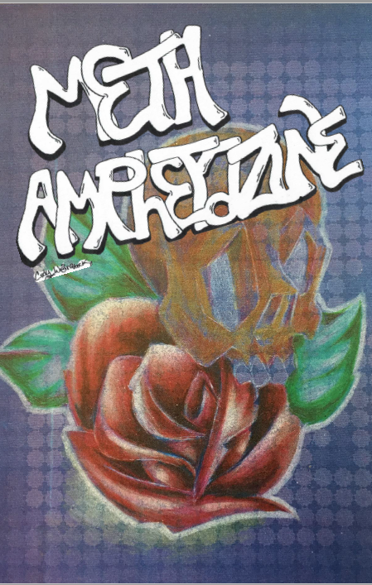
Syringes: Better Vein Care
Provide resources about the relative safety of injection practices and the anatomical injection sites on the body
Notes:
Injecting in the same vein repeatedly causes damage to the vein. Thus, planning to use a variety of injection sites improves vein health. This is known as “rotating” injection sites. Classic sources of information include Chicago Recovery Alliance’s Better Vein Care/Safer Injection Guide (https://anypositivechange.org/wp-content/uploads/BVCSI_all.pdf) and Harm Reduction Coalition’s Getting off right: A safety manual for injection drug users (http://harmreduction.org/wp-content/uploads/2011/12/user2user.pdf).
Focus on resources that center the voices of people who use drugs. Ask participants in your program to contribute to your understanding.
What could go in your educational pamphlet:
English/Spanish (or other second language specific to your communities)
“Who gave you this kit?” include brief mission statement, available services, hours and location of services
“What is harm reduction?” note: non-judgmental, practical strategies for increasing safety
Diagrams & Explanations: an appropriate reading level for your communities
No need to “reinvent the wheel” – find the resources that meet your communities’ needs

Slide 18
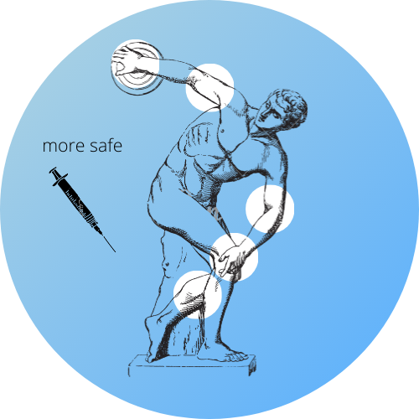
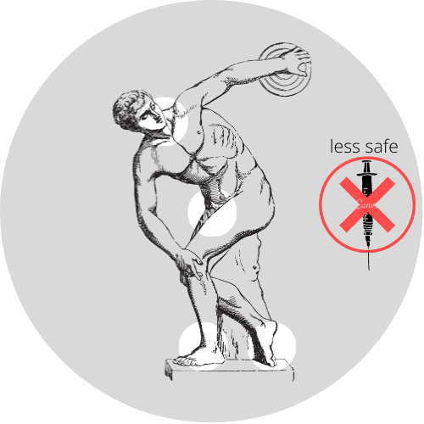
Syringes: Better Vein Care
Engage in better vein care or take a break from injection
“booty bumping,” inhalation, sniffing, or other drug administration styles
Follow the hierarchy of safety of IV injection sites from safer to less safe
arms, hands, legs, then feet. Avoid veins that cross over joints and local infection/injury.
injecting into your groin or neck or over joints
Notes:
Start with injection sites further from the heart and move closer to it to reduce the risk of dislodging a clot from an earlier injection site.
Vein care includes:
regularly exercising muscles, which makes accessing veins easier,
tense and then relax local muscles repeatedly to increase blood flow to the area or tap sharply over the vein to induce reflexive vasodilation
learning to identify and then inject above or below valves
drinking a glass of water instantaneously plumps veins
warming your body up with a warm compress, shower or exercise to bring veins to the surface
injecting bevel up with the flow of blood
choosing the veins that are safer to inject into, as in not near a vulnerable part of the body
Give veins a rest and try other ways to ingest drugs. Other drug administration styles may not achieve the same “rush” as IV injection but drugs will still absorb most quickly from the rectum and more quickly from nose and lungs than ingesting by mouth.

Slide 19
Section Two: Waste Collection

Slide 20
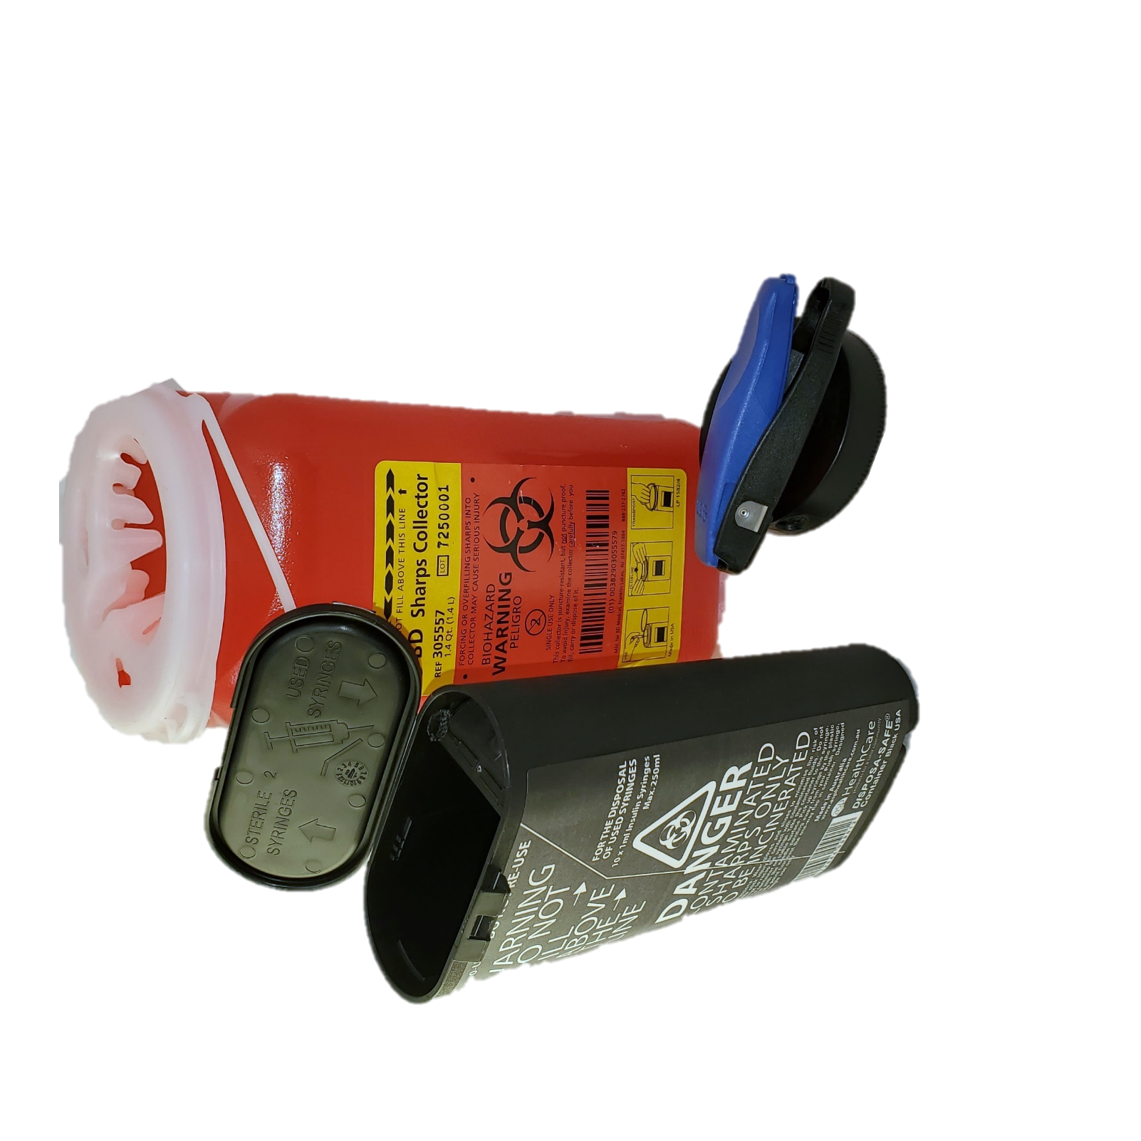
Waste Collection
Sharps – syringes, needles, lancets, etc. – need special disposal.
In addition to disposal, offer biohazard waste disposal containers and needle clipping devices.
Notes:
SSPs offer biohazard disposal, through hauling and incinerations contracts, biohazard disposal practices through a local incinerator, and/or onsite, on demand remediation devices, such as the Sterilis Solutions System.
Offering biohazard waste disposal containers to participants help them travel to and from the program with syringes more safely. However, not every syringe will be discarded at a program, and other information and resources can be provided. It is common to offer sharps containers ranging in size from 1 quart to 2 gallons. One product, the Fitpack sharps container, is well designed for participants because it can fit in a pants pocket or purse, it stores up to 10 1ml syringes, it is reclosable and has a divider that allows for storage of unused syringes and disposal of used ones.
BD Safe-Clip - used to clip the needles from the barrel of the syringe to prevent accidental sticks. Insert the needles into the hole on the side of the device and press down on the lever to cut off the needle. It can store up to 1500 needles.
Sharps are often allowed to be discarded in household garbage – not recycling – when properly contained. All used sharps must be placed in a strong plastic container, filled no higher than ¾ full, taped shut and labelled. Laws vary from state to state. Safeneedledisposal.org helps spread public information about legal disposal practices, which vary from state to state.
Syringe litter can dominate community conversation about SSPs (Barbour K, Augustine D, Newark C (2018). Syringe litter: mythology, blame, and power. Presenter. National Harm Reduction Conference, New Orleans, 2018. https://kylebarbour.org/pub/syringe-litter.pdf), so programs that take a proactive stance may benefit. A good resource for understanding the issue is AIDS United’s The Right Hit section on “syringe litter” (https://www.aidsunited.org/resources/therighthit).
Furthermore, staff can be protected by following Occupational Safety and Health Administration’s universal precautions. Training is available: Workforce Safety for Syringe Service Programs by AIDS United (https://www.aidsunited.org/resources/workforce-safety-for-syringe-service-programs).

Slide 21
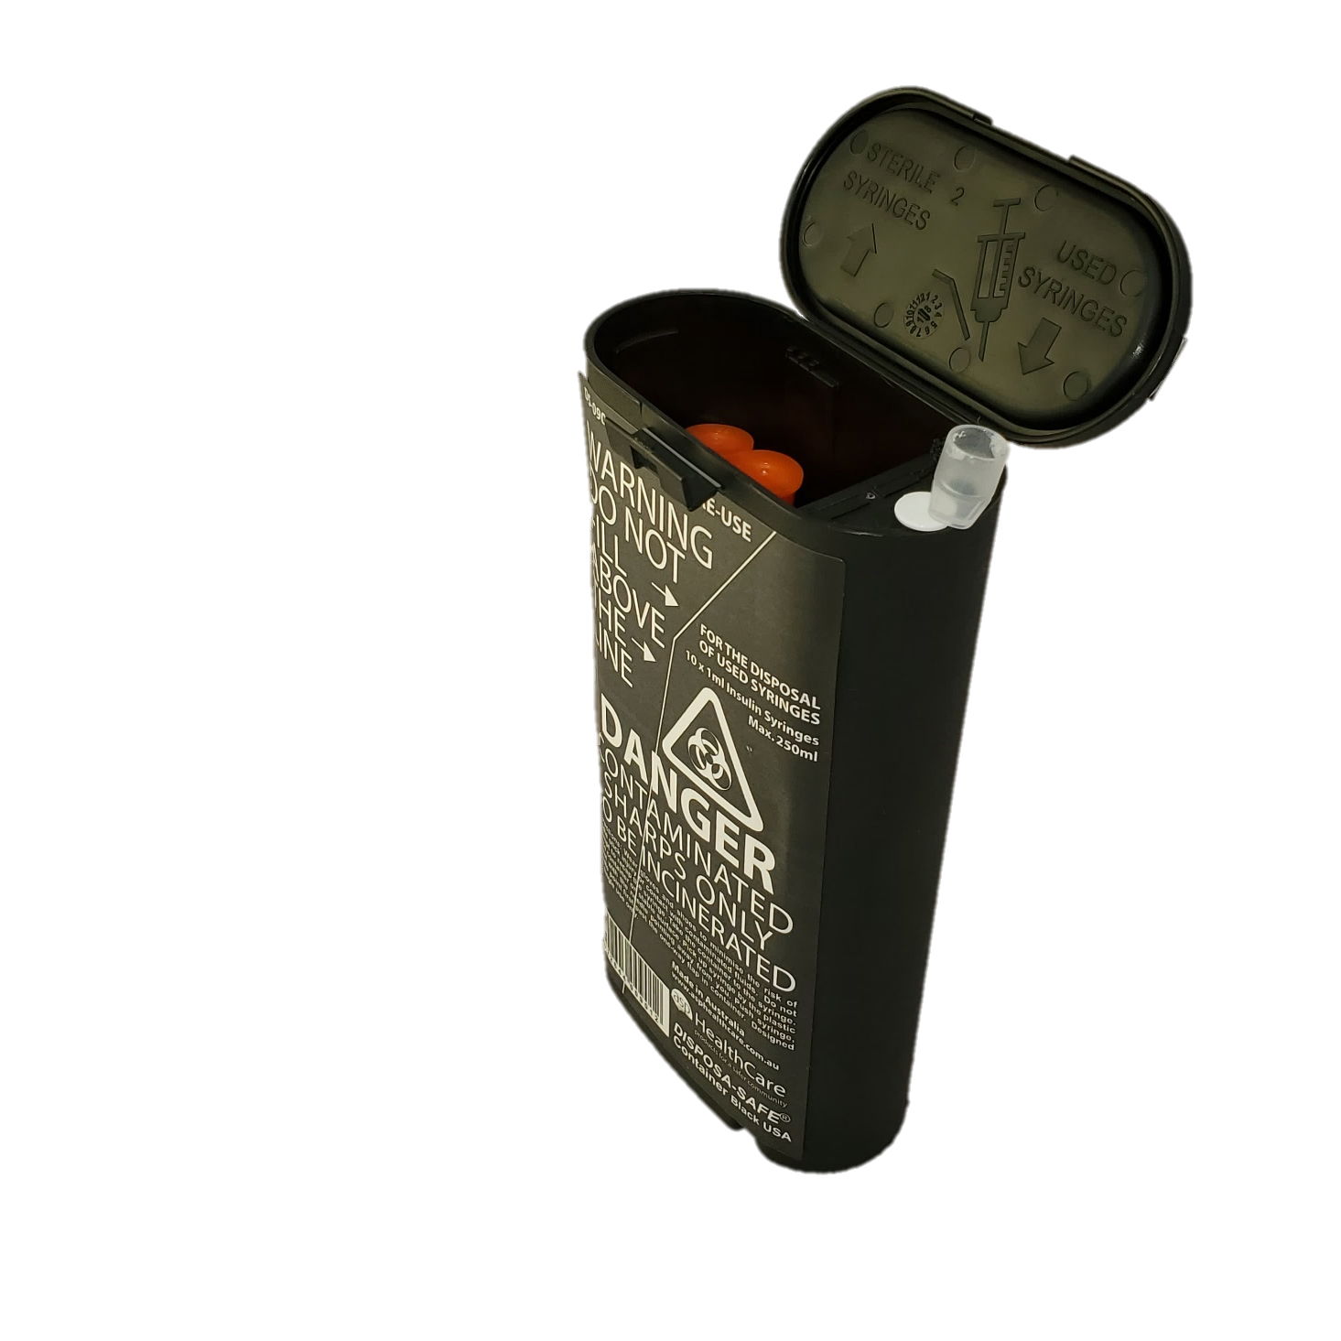
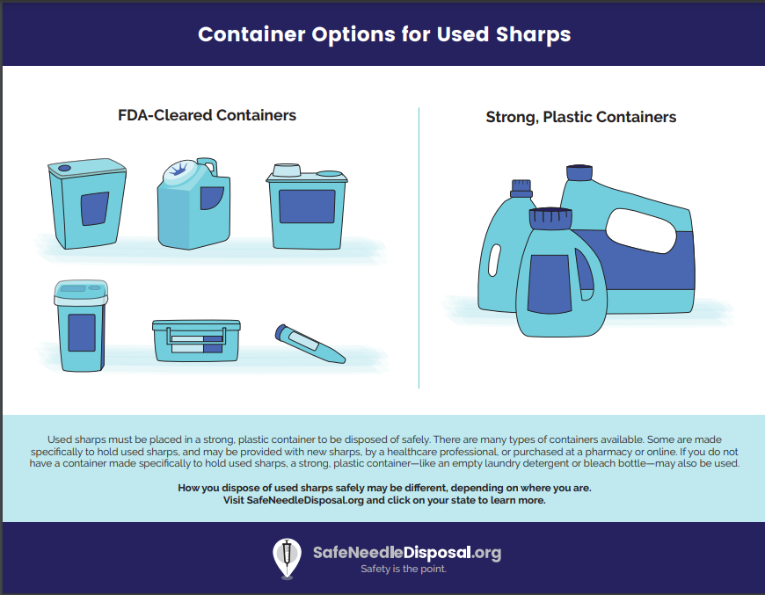
Waste Collection
Return syringes for biohazard disposal at an SSP or other healthcare center.
Discard loose syringes in a biohazard disposal bin or recycled hard plastic bottles, like detergent bottles, and when full place the secured and labelled container in the trash.
Placing your bin in the recycling. Discarding loose syringes in the street or public garbage. Clipping the needle tips off and discarding loosely.
Notes:
What plastics can be repurposed as a biohazard disposal bin?
#2 plastic, which is called high-density polyethylene (HDPE). For example: sturdy bottles for laundry detergent, house cleaners, or water, juice and milk jugs.
#3 plastic, which is called polyvinyl chloride (PVC) For example: sturdy bottles for window cleaner and detergents and some plastic squeeze bottles, cooking oil and peanut butter jars.
#5 plastic, which is polypropylene (PP). For example: syrup containers and clouded baby bottles.
#7 plastic, which is difficult-to-recycle plastics that recycling facilities usually do not accept. For example: medical storage containers, five gallon and “sports” water bottles, and clear plastic “sippy” cups.
What plastic bottles are not suitable for repurposing as a biohazard disposal bin?
#1 plastics, which are polyethylene terephthalates (PETE or PET plastics). For example: frequently used water and beverages bottles, food jars and containers, salad dressing and oil bottles, mouthwash bottles. Plastic #1 is usually clear, and since it is porous, it is not intended for multiple uses. PET plastic is easy for facilities to recycle into pillows, jackets, sleeping bags, and new bottles. so opt for a recycling bin and do not repurpose for sharps.
SOURCES: The Environmental Research & Educational Foundation (2018). Household Needles in Municipal Solid Waste (MSW) Report. Retrieved from erefdn.org. Also, Smart Plastics Guide for PBS’s Strange Days on Planet Earth, compiled by Sea Studios Foundation with sources including Earth911.org, Institute of Agriculture and Trade Policy, WHO International Programme on Chemical Safety, and US EPA. Retrieved from https://www-tc.pbs.org/strangedays/pdf/StrangeDaysSmartPlasticsGuide.pdf.
Empathize with participants who are attempting to discard syringes in minimally harmful ways while having to cope with the threat of law enforcement. Syringe Possession has been used to convict people of possession of drugs and of paraphernalia.
The major factors influencing syringe litter are police and laws. Source: Soc Sci Med 1982. 2005; 61(3):673–684

Slide 22
Section Three: Materials used before, during, and after drug preparation
Notes:
Injection equipment aka “works” bags

Slide 23
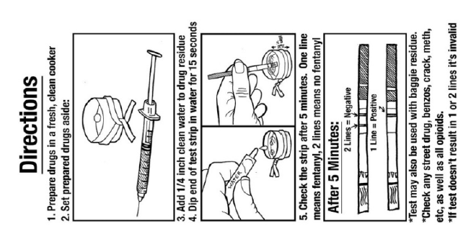
Drug Checking
Point-of-care drug testing and fentanyl test strip distribution help
avoid ingestion of unknown and potentially more dangerous adulterants found in drugs
identify trends in drug markets, so agencies can better serve the needs of the community
Notes:
Disclaimer: The U.S. Food and Drug Administration (FDA) cleared the use of FTS as a dipstick for detecting fentanyl in urine by trained medical personnel. However, the FDA has not evaluated or approved the use of FTS for the purpose of checking diluted, illicit drugs for the presence of fentanyl, prior to consumption.
Drug checking, also known as pill testing or adulterant screening, is a harm reduction service that helps drug users avoid ingesting unknown and potentially more dangerous adulterants found in street drugs.
Drug checking services may also assist emergency medical professionals and public health agencies in identifying trends in drug markets, so they can better serve the needs of the community.
Examples:
Point-of-care drug testing
Handheld infrared spectroscopy, Raman spectroscopy, and ion mobility spectrometry
Mass spectrometry is the current gold standard in forensic drug analysis.
Lower tech options, such as spot/color tests and immunoassays, are limited in their use but affordable and easy to use.
Reagent testing available from
Rollsafe (MDMA only)
DanceSafe $35 incl shipping, $22 extra for overnight shipping
Bunk Police $33 incl shipping, $22 extra for overnight shipping
Fentanyl test strips are commonly distributed at SSPs and can be used to test drugs for trace amounts of fentanyl.
1 red line = positive, 2 red lines = negative.
These are designed as urine drug screenings but work with drug preparation solutions too.
The cost is about $1 or less per testing strip

Slide 24
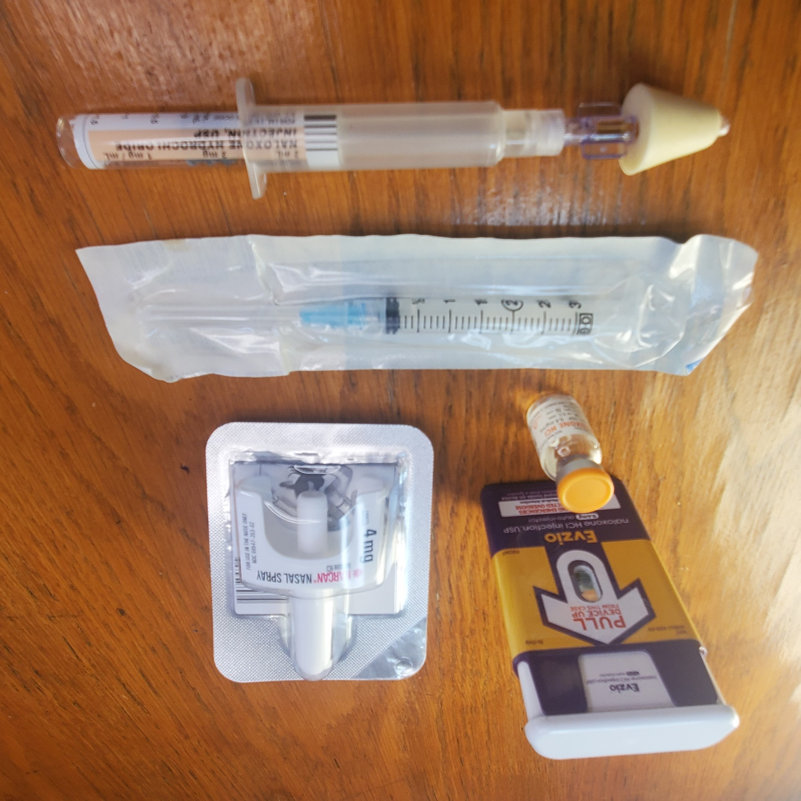
Overdose Prevention
Fentanyl test strips
Fentanyl test strips can be used to test drugs for trace amounts of fentanyl. 1 red line = positive, 2 red lines = negative.
Naloxone
Nasal Spray
Amphastar, requires assembly
Adapt Pharma’s Narcan brand nasal spray
Naloxone Vials
Layperson use with IM needle, inject into muscle
Paramedics provide intravenously
Autoinjector
Kaleo brand
Rescue breathing
Safety Planning
Food and drink
Notes:
Fentanyl test strips can be used to test drugs for trace amounts of fentanyl. 1 red line = positive, 2 red lines = negative. These are designed as urine drug screenings but work with drug preparation solutions too. Disclaimer: The U.S. Food and Drug Administration (FDA) cleared the use of FTS as a dipstick for detecting fentanyl in urine by trained medical personnel. However, the FDA has not evaluated or approved the use of FTS for the purpose of checking diluted, illicit drugs for the presence of fentanyl, prior to consumption.
There are a lot of great resources for naloxone and overdose reversal. The website naloxoneforall.org includes a lot of great tutorials for people who use drugs and their loved ones, and the site https://prescribetoprevent.org/ includes resources that are helpful for prescribers, pharmacists, and other community members.
Tools that aid in rescue breathing include pulse oximeter, face shield, and bag valve mask. Programs may consider offering these supplies or keeping them on site in case of emergency.
When someone has recently experienced an opioid overdose, discussing a safety plan helps that person to maintain focus on self-care and strategies to prevent future overdoses. As you craft a safety plan with a person who has survived an overdose, provide appropriate and accurate information about low-barrier harm reduction services that you offer or that are available in your community.
Self-care, including rest, food, and hydration, help prevent overdose. Encourage program participants to eat, drink, and sleep by offering beverages, snacks, and help with finding housing, like offering social work counseling and/or resource guides for shelters.

Slide 25
Overdose Prevention
Use with a friend, check drug potency, and have naloxone on hand.
If using alone is unavoidable, text or call someone.
Using product of unknown potency alone without telling anyone.
Best: Use with a friend, check drug potency, and have naloxone on hand.
OK: If using alone is unavoidable, text or call someone.
Please avoid: Using product of unknown potency alone without telling anyone.
Take care of each other. Ask someone to be prepared for all outcomes to care for you when you use. And reciprocate!
Quarantine, stay-at-home orders and physical distancing requirements for COVID-19 can increase overdose risk.
If someone must be physically alone, then webcam, phone, and text can be used for check ins.
Drug-use safety monitoring resources, like Never Use Alone and BeSafe can help too.
Notes:
Quarantine, stay-at-home orders and physical distancing requirements for COVID-19 can increase overdose risk. If someone must be physically alone, then webcam, phone, and text can be used for check ins. Drug-use safety monitoring resources, like Never Use Alone and BeSafe can help too. Make use of drug-use safety monitoring resources such as Never Use Alone (visit http://neverusealone.com/ or phone/ text 800-484-3731) and BeSafe (https://www.besafe.community/ or on Google play and Apple app store).
SOURCE: COVID-19 Harm Reduction Toolkit, created by Higher Ground Harm Reduction, Reynolds Health Strategies and global health organization Vital Strategies. Retrieved from https://www.vitalstrategies.org/wp-content/uploads/covid_harmreduction_combined_toolkit-8.pdf
Drug potency varies. Fentanyl test strips help identify its presence, but not its potency. “Tasting” - A practice of injecting a tiny amount of drug solution initially to learn the strength of the solution has been used to prevent overdose. Some people avoid this practice because they are concerned it may dilute the impact of their shot.
Sometimes using alone is unavoidable. Is someone available to check in by call or text instead? New apps are designed to sound an alarm if a message to you goes unanswered.
Ask program participants what has worked well for them in the past. Provide a self assessment tool to participants that identifies levels of risk and strengths and gaps in preparedness. Craft personalized safety tips and a safety plan checklist. Encourage them as agents of change with the ability to grow from a place of strength.
A resource that includes templates for self assessment, safety tips, and change plans is AIDS United’s Post-Overdose Care webinar https://www.aidsunited.org/webinars/post-opioid-overdose-linkage-and-care

Slide 26
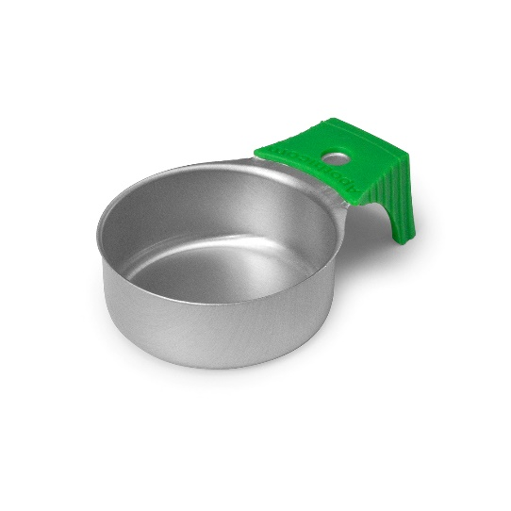
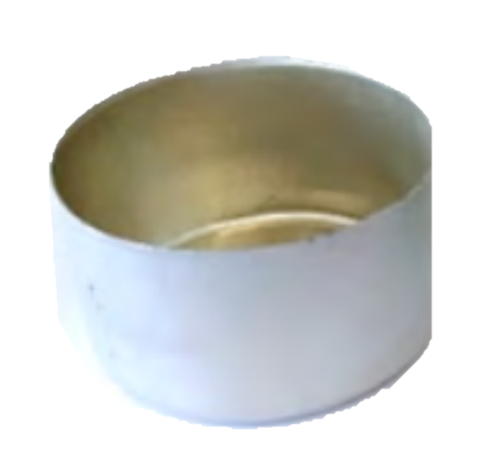
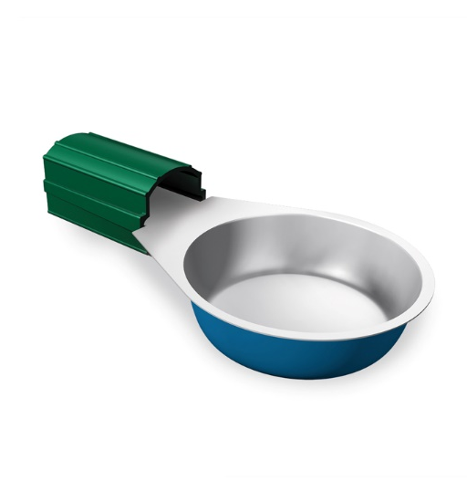
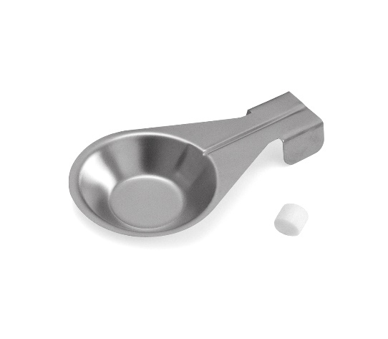
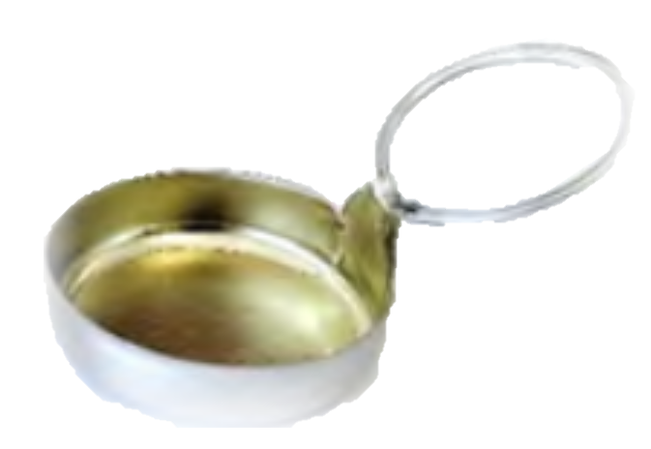
Drug Preparation: Cookers
Before administration, drugs are mixed in “cookers” and heated and dissolved with a lighter or candle.
Cookers should be heated 15 seconds or longer
Used and/or shared cookers may harbor HIV and/or HCV
HCV has been found after 3-6 weeks
“Cookers” is a broad term that includes spoons and a variety of products that have been developed or repurposed to target prevention efforts.
Notes:
HCV can survive on dry surfaces and equipment for up to 6 weeks. HIV does not survive long outside the body or when it comes into contact with air, but shared injection equipment may contain trace blood, and blood contact can spread HIV.
Sizes: 2.5 mL, 3 mL, 5mL
Material: Aluminum, Stainless Steel
Some products come individually wrapped with built-in filtration and cotton swabs. Others are bulk bottle caps that can be packaged by staff into “works” bags. When cookers come loose and in bulk, participants may request bread ties, which can be fashioned into handles for the cooker.
Features:
Sterile
Some are irradiated and lot and batch numbered for traceability
Colored cooker to avoid accidental sharing
Prewrapped with cotton filter
Burn Free handle, or long handle
low-conductivity of the handle, does not heat up quickly during the cooking process.
Flat base for stability
Examples:
MaxiCup, SteriCup or SafeCooker by APOTHICOM Manufactured by: Laboratoire CAT, France. http://www.apothicom.org/stericup.php http://www.apothicom.org/downloads/Maxicup_fr_v1.pdf
DaniCup Manufactured by: Lewis’s Medical Supplies, UK http://www.danielsnx.co.uk/d.NX/
Steel Cooker by: Smiths Medical, UK http://www.harmreduction.co.uk/p/92/Spoon.html
Aluminum Rinse Caps (Smooth Surface) distributed by: Total Access Group, US http://www.totalaccessgroup.com/Aluminum-Rinse-Caps-Smooth-Surface_p_823... Or Safety Works, US http://1800safety2.com/harm-reduction-supplies.html
Aluminium Rinse Caps (Ridged/Beaded Surface) Distributed by: Total Access Group, US https://totalaccessgroup.3dcartstores.com/Aluminum-Rinse-Caps-RidgedBead... Safety Works, US http://www.1800safety2.com/
One-Use Spoon, distributed by: One-Use, Ireland http://one-use.com/one-use-spoon/
SOURCES:
Elijah Paintsil, Mawuena Binka, Amisha Patel, Brett D. Lindenbach, Robert Heimer, Hepatitis C Virus Maintains Infectivity for Weeks After Drying on Inanimate Surfaces at Room Temperature: Implications for Risks of Transmission, The Journal of Infectious Diseases, Volume 209, Issue 8, 15 April 2014, Pages 1205–1211, https://doi.org/10.1093/infdis/jit648
Shah SM, Shapshak P, Rivers JE, et al. Detection of HIV-1 DNA in needle/syringes, paraphernalia, and washes from shooting galleries in Miami: a preliminary laboratory report. J Acquir Immune Defic Syndr Hum Retrovirol. 1996;11(3):301-306. doi:10.1097/00042560-199603010-00010
Clatts MC, Heimer R, Abdala N, et al. HIV-1 transmission in injection paraphernalia: heating drug solutions may inactivate HIV-1. J Acquir Immune Defic Syndr. 1999;22(2):194-199. doi:10.1097/00126334-199910010-00013
Hagan H, Pouget ER, Williams IT, et al. Attribution of hepatitis C virus seroconversion risk in young injection drug users in 5 US cities. J Infect Dis. 2010;201(3):378-385. doi:10.1086/649783
Strike, C., Buchman, D.Z., Callaghan, R.C. et al. Giving away used injection equipment: missed prevention message?. Harm Reduct J 7, 2 (2010). https://doi.org/10.1186/1477-7517-7-2
Hagan H, Thiede H, Weiss NS, Hopkins SG, Duchin JS, Alexander ER. Sharing of drug preparation equipment as a risk factor for hepatitis C. Am J Public Health. 2001;91(1):42-46. doi:10.2105/ajph.91.1.42
Thorpe L, Ouellet L, Hershow R, Bailey S, Williams I Her show, Monerosso E. The multiperson use of non-syringe injection equipment and risk of hepatitis c infection in a cohort of young adult injection drug users, chicago 1997-1999. Ann Epidemiol. 2000;10(7):472-473. doi:10.1016/s1047-2797(00)00155-1
Pouget ER, Hagan H, Des Jarlais DC (2012) Meta-analysis of hepatitis C seroconversion in relation to shared syringes and drug preparation equipment. Addiction 107: 1057-1065. doi:10.1111/j. 1360-0443.2011.03765.x. PubMed: 22168373

Slide 27
Drug Preparation: Cookers
New “harm reduction” cooker caps every time
Sterilize a spoon or bottle cap (wash with soap and water, wipe with alcohol, dry)
Sharing or reusing cookers – bacteria grow quickly, HCV sticks around
Best: New “harm reduction” cooker caps every time
OK: Sterilize a spoon or bottle cap (wash with soap and water, wipe with alcohol, dry)
Please Avoid: Sharing or reusing cookers – bacteria grow quickly, HCV sticks around
Take as many cookers as you will have injections!
Notes:
Sharing cookers is an easy way to contract HCV! Most people think it’s just sharing needles, but it can live in cookers for up to a week! Take as many cookers as you will have injections!

Slide 28
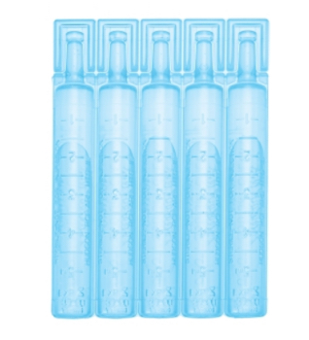
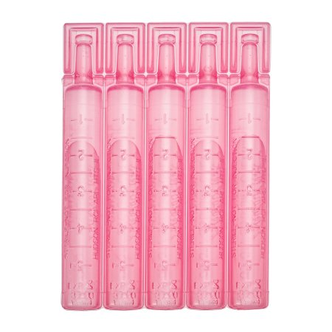
Drug Preparation: Water
Drug preparation includes the dissolving of drugs in water or saline solution. Rinse waters are also used to extract leftover drugs from filters when people face drug scarcity.
Studies have shown risk of exposure to HIV and HCV in waters.
SSPs can offer both counseling on safer practices on water access and access to sterile water ampules, which are repurposed from medical nebulizer treatments.
Notes:
Water ampules have the added benefit of easy to read in milliliter graduations (measurement markings) for precise mixing of drugs.
Water ampules repurposed from medical nebulizer treatments are labelled “not for parenteral administration” and “Rx ONLY.” They are commonly found in 3mL volumes, which is more than enough for one injection.
This is for liability purposes, yes they can be used for injection!
Sometimes your medical director will need to sign off on these orders, with the “Rx ONLY,” but not commonly.
Pink = saline, blue = water.

Slide 29
Drug Preparation: Water
Sterile water/saline strips (Addipaks), sealed bottled water, or boiled water
Opened bottles of water, tap water, water from back of toilet
Water from front of toilet, puddle/gutter water
Best: Sterile water/saline strips (Addipaks), sealed bottled water, or boiled water
OK: Opened bottles of water, tap water, water from back of toilet
Please Avoid: Water from front of toilet, puddle/gutter water
Open, hold and squeeze the water ampule rather than stick your needle through the plastic. Avoid dulling your needle point!
Notes:
If using in the restroom, go to the faucet, not the toilet. If there’s no sink, water from the back of toilet is acceptable but not recommended.
Yes, Addipaks may be used for things other than inhalation; they just say that on there because they’re made for hospital nebulizers, and it’s a liability thing.

Slide 30
Drug Preparation: Acidifier
Some drugs do not dissolve easily in water or saline solution and require acidifier.
Vitamin C (ascorbic acid) is a weak organic acid which is used as an acidifier.
It comes as a white powder that can be dissolved in water to form a mild acidic solution.
It is available in waterproof 300mg packets or in bulk.
Other acidifiers like vinegar or lemon juice are stronger acids that cause worse vein damage and may be contaminated with bacteria or fungus.
Notes:
Lemon juice and vinegar are widely available but they are harsher acids, causing more pain, irritation, and damage to the veins, which may cause veins to collapse.
Vinegar and lemon juice may also be contaminated with bacteria or fungus, lead to life-threatening infections including abscesses, cellulitis and heart infections, or eye infections causing blindness.
Medical-grade vitamin C is the safest acidifier. It causes the least damage to the veins, is non-toxic, and is sterile, reducing or eliminating the harms associated with other acids.
Shared acidifiers, like shared needles and other injecting paraphernalia, may transmit infection such as hepatitis C or HIV between users
SOURCES:
Garden J, Roberts K, Taylor A, Robinson D. Evaluation of the provision of single use citric acid sachets to injecting drug users. Edinburgh: Effective Interventions Unit, Scottish Executive Drug Misuse Research Programme, University of Paisley. 2004.
Darke S, Ross J, Kaye S. Physical injecting sites among injecting drug users in Sydney, Australia. Drug and Alcohol Dependence. 2001;62:77-82. 5 Gordon RJ, Lowy FD. Bacterial infections in drug users. New England Journal of Medicine. 2005;353(18):1945-1954
Servant JB, Dutton GN, Ong-Tone L, Barrie T, Davey C. Candida endophthalmitis in Glaswegian heroin addicts. Report of an epidemic. Transactions of the Ophthalmological Societies of the United Kingdom. 1985;104:297-308.
Martinez Vazquez C, Fernandez Ulloah J, Bordon J, Sopeña B, de la Fuente J, Ocampo A, Rubianes M. Candida albicans endophthalmitis in brown heroin addicts: Response to early vitrectomy preceded and followed by antifungal therapy. Clinical Infectious Diseases. 1998;27:1130-1133.

Slide 31
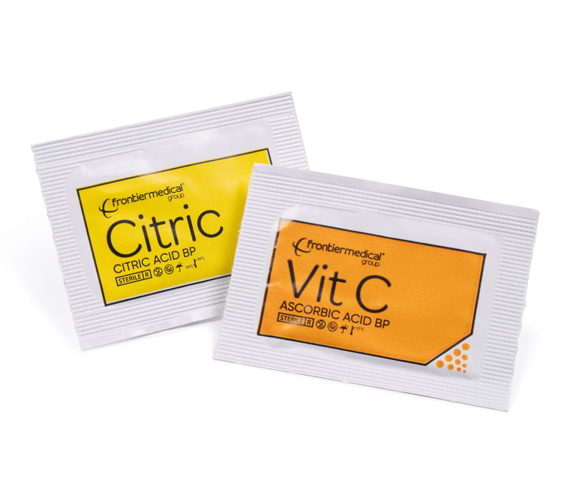
Drug Preparation: Acidifier
Smallest amount of Vitamin C or ascorbic acid from a packet
Bulk Vitamin C (ascorbic acid)
Vinegar, lemon juice or drink packets with sugar and dyes in them or lemon juice
Best: Smallest amount of Vitamin C or ascorbic acid from a packet
OK: Bulk Vitamin C (ascorbic acid)
Please avoid: vinegar, lemon juice or drink packets with sugar and dyes in them or lemon juice
Notes:
Add very small amounts of vitamin C until the drug is fully dissolved.
For crack, the amount of vitamin C required is about ¼ the size of the rock; however for crack and brown or black tar heroin, the amount of vitamin C needed to fully dissolve the drug varies with the purity of the drug.
Once the packet of vitamin C is opened, any left over should be thrown away, so that it does not become contaminated and cause an infection.
While bulk options are OK, it can be made of large, course grains, which increases the chances of adding in too much in a solution.

Slide 32
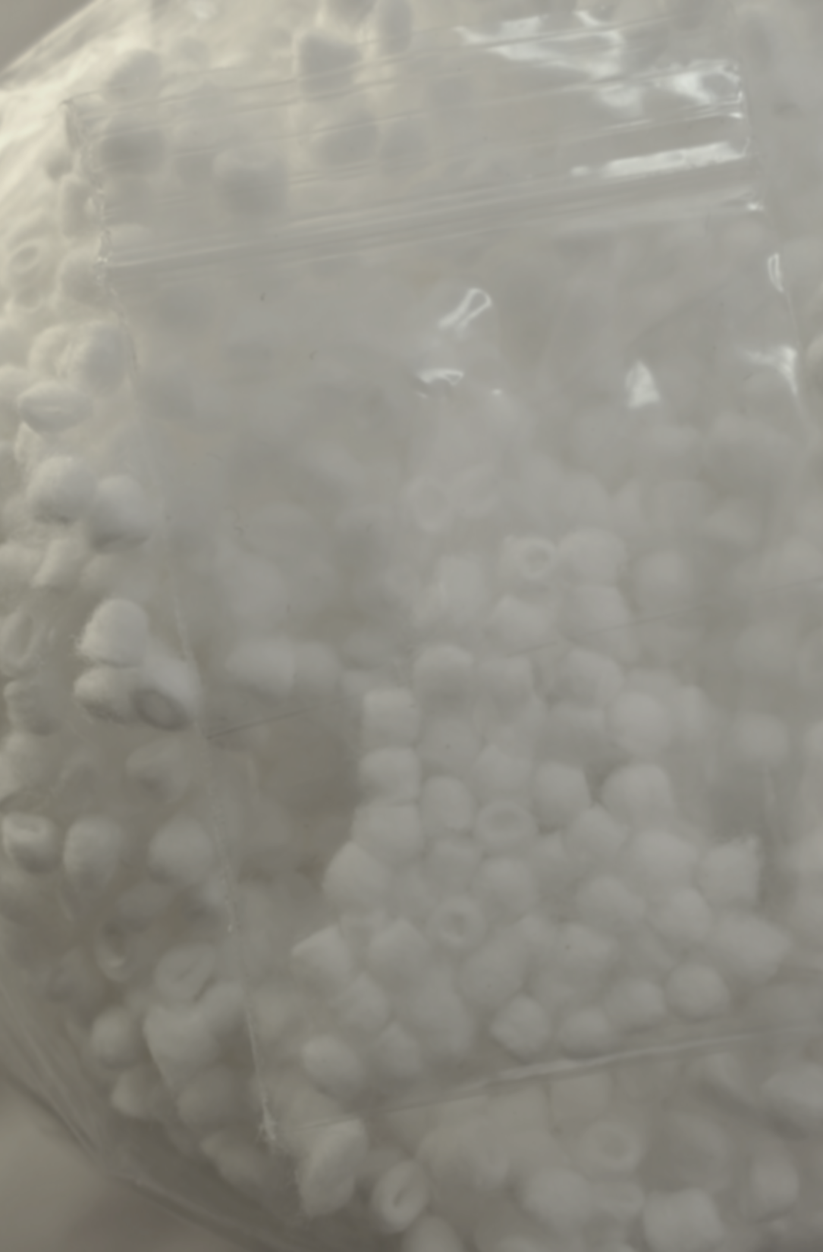
Drug Preparation: Filters
Injections of mixtures contain insoluble particles that can cause embolisms and other complications.
Cotton pellets are used to filter out undissolved particles after the drug preparation has been heated, when it is being drawn up into a syringe.
Sharing or use of old filters risks exposure to microorganisms like Staphylococcus aureus, Candida, HIV and HCV.
Notes:
Cotton pellets can be purchased in bulk (10lb) or by the box (0.5lb) in several sizes (#2 = 7/32 inches, #3 = 5/32 inches, #4 = 1/8 inch). Similar to cotton cellulose filters.
Packaging of cotton pellets will depend on each program’s safer injection works bags. One way to package cottons is in a pillow pack with between 20-60 cottons in each bag. If packing kits so 1 kit is distributed per 1 ten pack of syringes, then aim to pack 10-20 cottons in each bag. The quantity doesn’t need to be precise, whoever is packing cottons should find a pace that allows for somewhat quick packing. Workers should wash hands with soap and water and wear gloves prior to packing cottons and void touching anything else.
Another option are filters that fit into two piece syringes via luer lock and are measured by the micron size they filter down to. These types of high performance filters are able to remove very small particles without absorbing liquid, and attach easily to a variety of syringes. However, they are not as easily affordable or accessible as cotton pellets.
Embolus can cause: DVT, Stroke, heart attack
A study that prepared slow-release morphine tablets (MS Contin®) and tested out different filters found that
Tablet extracts contained tens of millions of particles with a range in sizes from < 5 μm to > 400 μm.
Cigarette filters removed most of the larger particles (> 50 μm) but the smaller particles remained.
Commercial syringe filters (0.45 and 0.22 μm) produced a dramatic reduction in particles but tended to block unless used after a cigarette filter.
Morphine was retained by all filters but could be recovered by following the filtration with one or two 1 ml washes.
The combined use of a cigarette filter then 0.22 μm filter, with rinses, enabled recovery of 90% of the extracted morphine in a solution which was essentially free of tablet-derived particles.
The 0.22 μm filter is to be preferred, as it can remove the organisms (e.g. Staphylococcus aureus, Candida) which commonly produce cutaneous and systemic infections in injecting drug users.
Harm can be substantially reduced by passing the injection through a (0.22 μm) filter.
To prevent the filter from blocking, a preliminary coarse filter (such as a cigarette filter) should be used first.
The filters retain some of the dose, but this can be recovered by following filtration with one or two rinses with 1 ml water.
This remains an unsafe practice due to skin and environmental contamination by particles and microorganisms, and bloodborne infections.
Although particles can be removed by filtration, many people do not filter due to availability, cost or performance of filters, and due to concerns that some of the dose will be lost.
SOURCES
McLean, S., Bruno, R., Brandon, S. et al. Effect of filtration on morphine and particle content of injections prepared from slow-release oral morphine tablets. Harm Reduct J 6, 37 (2009). https://doi.org/10.1186/1477-7517-6-37
Shah SM, Shapshak P, Rivers JE, et al. Detection of HIV-1 DNA in needle/syringes, paraphernalia, and washes from shooting galleries in Miami: a preliminary laboratory report. J Acquir Immune Defic Syndr Hum Retrovirol. 1996;11(3):301-306. doi:10.1097/00042560-199603010-00010
Thorpe L, Ouellet L, Hershow R, Bailey S, Williams I am, Monerosso E. The multiperson use of non-syringe injection equipment and risk of hepatitis c infection in a cohort of young adult injection drug users, chicago 1997-1999. Ann Epidemiol. 2000;10(7):472-473. doi:10.1016/s1047-2797(00)00155-1
Hagan H, Thiede H, Weiss NS, Hopkins SG, Duchin JS, Alexander ER. Sharing of drug preparation equipment as a risk factor for hepatitis C. Am J Public Health. 2001;91(1):42-46. doi:10.2105/ajph.91.1.42

Slide 33
Drug Preparation: Filters
New cotton pellet for each new cooker for each new needle (each new shot)
Unused cotton swab or tampon (cotton) or cigarette filter (cellulose)
Old cottons
Best: New cotton pellet for each new cooker for each new needle (each new shot)
OK: Q-Tip or tampon (cotton) or cigarette filter (cellulose)
Please Avoid: Old cottons
Why? Filter out large particles/contaminants, prevent clot/embolus
Notes:
In this unregulated drug market drugs are cut with who knows what. This “who knows what” can, if injected instead of filtered out, become an embolus (a solid thing that clots in the bloodstream). An embolus can cause such complications as deep vein thrombosis, stroke, or heart attack
Cotton fever – anecdotally, it’s because you inject little pieces of cotton you feel feverish and ill. It’s actually due to bacteria, Pantoea agglomerans, which commonly colonizes cotton plants, that precipitates the rapid (within 15-30 mins) and rarely serious symptoms of fever, headache, *chills/shivering,* nausea, joint and muscle pain; normally self-resolves within a day, can take a warm bath and some ibuprofen to reduce symptoms. There is always a risk with using cotton to inject, so that’s why you use a new, tightly rolled one every time
For Q-Tips or tampons, it is best to tightly roll (with clean and gloved hands) little wisps of cotton to reduce risk of long strands of cotton entering the veins and causing an embolus.
Cigarette filters are made of cellulose, NOT fiberglass. Nevertheless, still not ideal to inject it because cellulose particulate may lead to an embolus. Filters from smoked cigarettes should never be considered.

Slide 34
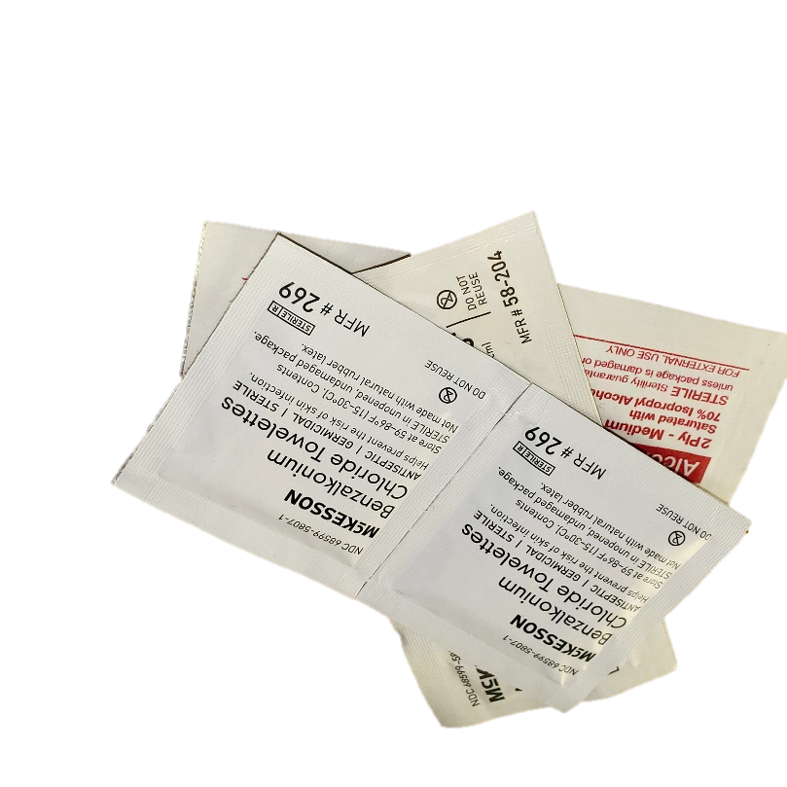
Injection: Skin Cleaning
Sterilize the injection site with:
Soap and water
BZK Wipes
BZK is short for benzalkonium chloride, an antiseptic for cleaning hands and other body parts when soap and water is not available. They can be used to cleanse broken skin and wounds.
Alcohol pads
Used to clean an injection site prior to injection to remove bacteria and germs that could be pushed into the skin dur- ing the injection process.
Notes:
Commonly distributed alcohol wipes are medium in size and usually 70% isopropyl alcohol

Slide 35
Injection: Skin Cleaning
Soap and water, then alcohol wipe
Just alcohol pad; liquor (without sugar)
No cleaning at all.
Best: Soap and water, then alcohol wipe
OK: Just alcohol pad; liquor (without sugar)
Please Avoid: Nothing
Best practice for alcohol wipes: avoid back and forth. Two methods: wipe out in a spiral pattern or wipe down in one direction.
Notes:
A community of microorganisms lives on the surface of our skin and benefits us. But these same organisms can do harm in our blood. Sterilize the injection site using soap and water, first, and alcohol afterward. Don’t just rub alcohol pad around because that just spreads bacteria around without getting it away. Imagine washing a window, clearing grime off it by wiping in a spiral pattern.
Avoid alcohol with sugar because sugar encourages bacterial growth and causes sticky skin.
Please avoid: wiping with an alcohol pad post-injection, it will prevent blood from clotting.

Slide 36
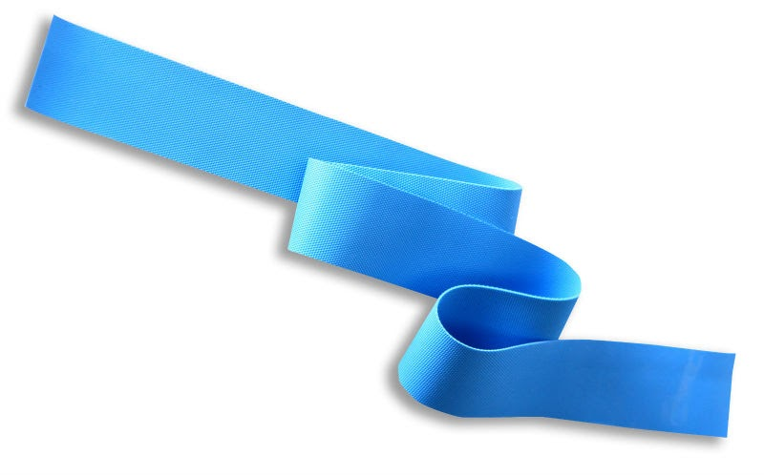
Injection: Tourniquet
Applying a tourniquet above the injection site increases the size of vein to improve injection accuracy, and the hole from the injection becomes smaller after removal of the tourniquet, thereby reducing wound and healing time.
The material used as a tourniquet should be easy on the skin and have elasticity
A tourniquet should be easy to remove one handed, via a slip knot.
Tourniquets pose infection risk if splashed with blood and should be sterilized if reused.
Notes:
The purpose of the tourniquet is to restrict blood flow and cause the veins to bulge. A tourniquet should restrict venous return without impairing arterial circulation; to assure arterial patency check for a distal pulse. Tying the tourniquet with a slipknot above the site of injection allows a user to release the tourniquet one handed with ease. Tourniquets should be sterilized with an alcohol pad in between uses.

Slide 37
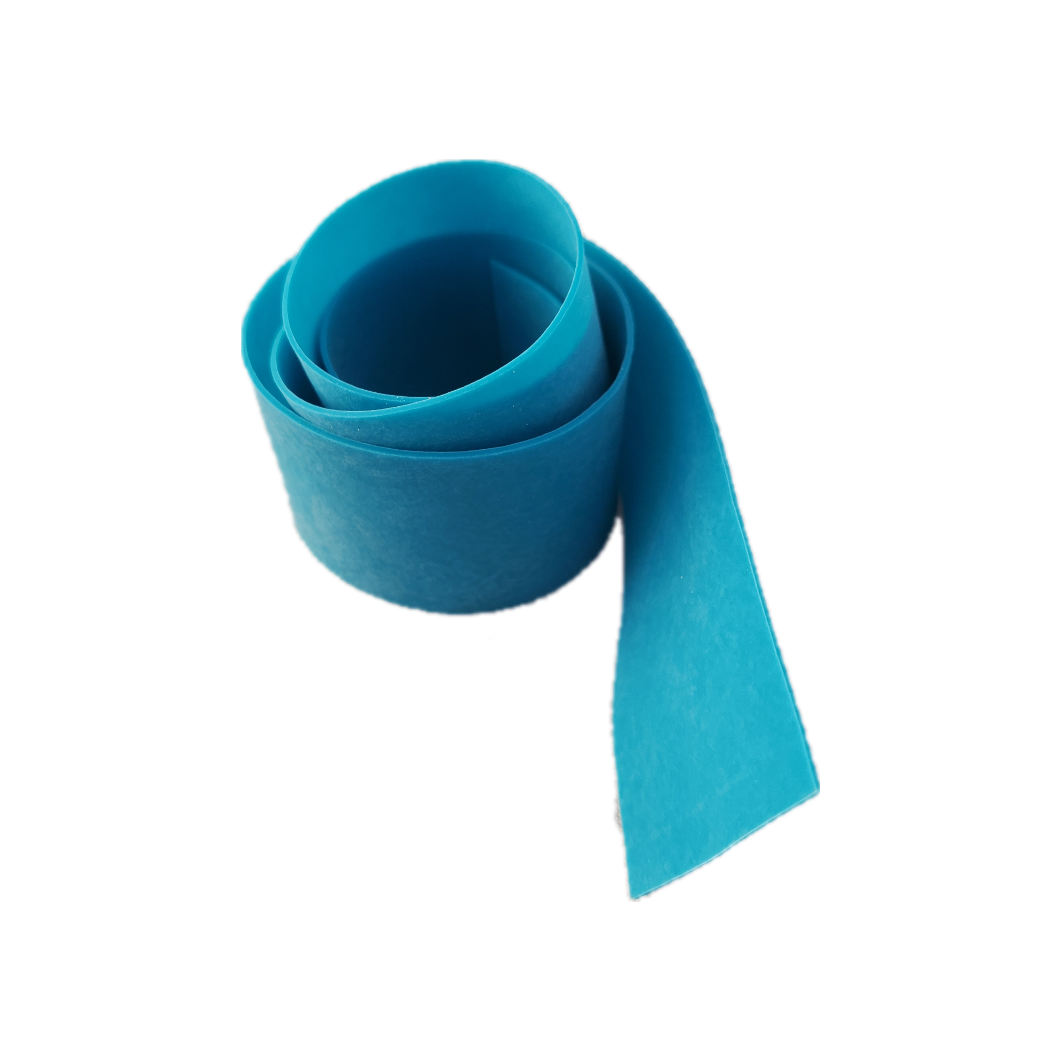
Injection: Tourniquet
Hospital grade/harm reduction tourniquets
Bike inner tube, stockings, something stretchy
Hair ties, belts, neck ties, or using no tourniquet
Best: Hospital grade/harm reduction tourniquets
OK: Bike inner tube, stockings, something stretchy
Please Avoid: Hair ties, belts, neck ties, or using no tourniquet
Notes:
Elastic tourniquets or stockings cause less harm to the skin than leather belts without stretch.
Hair ties are difficult to get off. Anything used as a tourniquet should be tied with a slip knot that can be easily removed.
Some found objects that work well as tourniquets include, lubricated condoms, bike inner tubes cut to size, or stockings. Socks and neckties may work in a pinch, but belts are not recommended.
Ideal length is like around a foot or 18 inches. The length should allow for the ease of tying a slipknot.

Slide 38
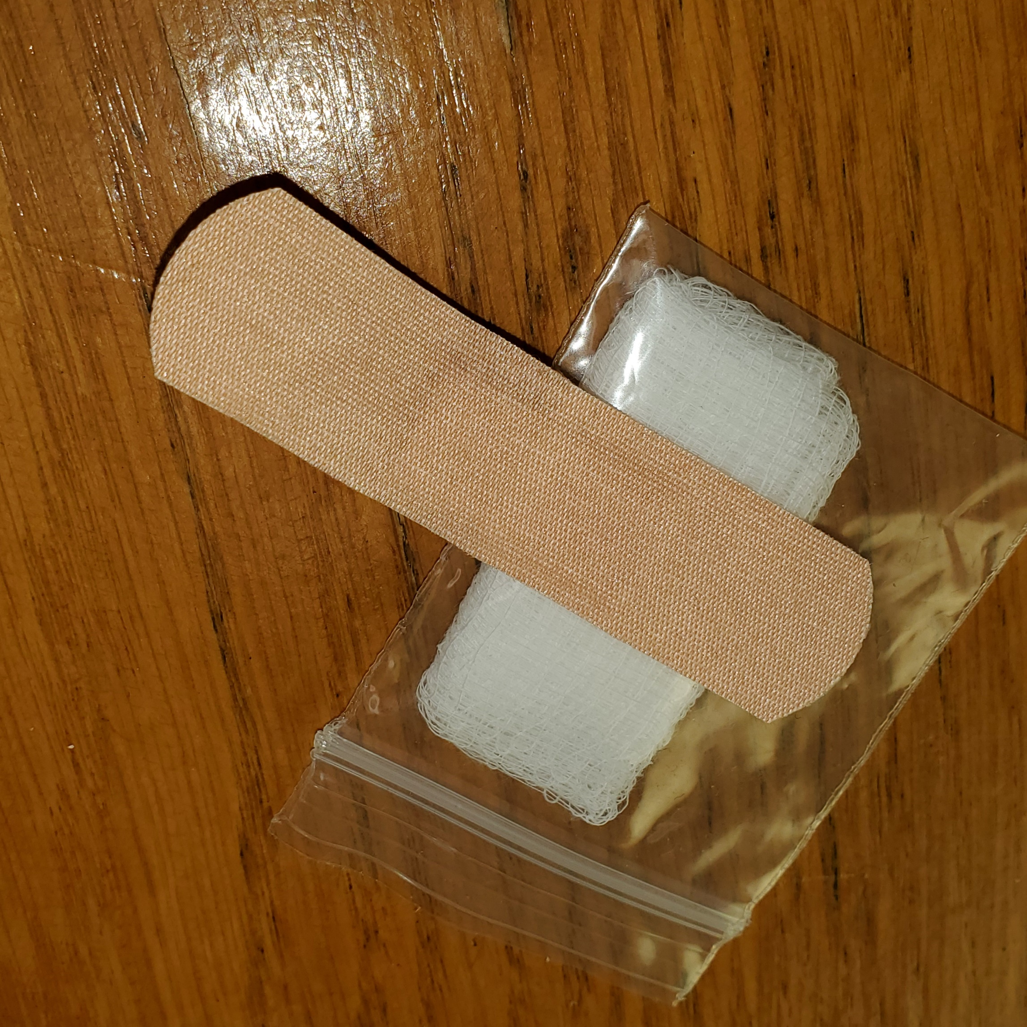
Caring for Injection Sites: Gauze
Stem the blood flow as soon as possible following injection
Apply direct pressure to puncture area immediately after needle is removed and elevate extremity
Benefits include:
reduce bruising, bleeding, and infection risk
promote healing
Notes:
Offer something sterile to stop bleeding, like gauze and a bandage or tape. Participants can use clean cloth or tissue. Hepatitis B and C can live on surfaces, so sterile is best.

Slide 39
Caring for Injection Sites: Gauze
Cloth, tissue, gauze
Cotton ball, sock, towel
Alcohol wipes, which prevent blood clotting
Best: Cloth, tissue, gauze
OK: Cotton ball, sock, towel
Please avoid: Alcohol wipes, which prevent blood clotting
Notes:
Apply pressure to the injection site with a clean material immediately after withdrawing the needle in order to reduce bruising and excess bleeding and to help reduce infections and promote healing.
Ideally keep pressure on the site for 3-5 minutes. Covering gauze with compression bandage or tape can help. If on aspirin or other blood thinner, double the time you apply pressure.
Using an alcohol wipe will increase the blood flow over time and increase risk. It prevents healing of the injection site.

Slide 40
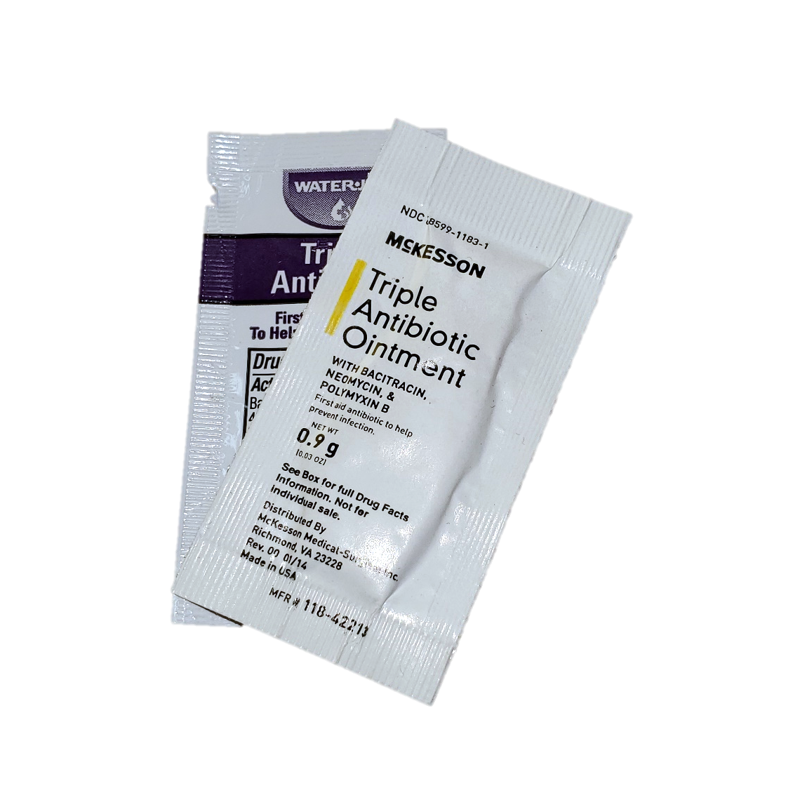
Caring for Injection Sites: Ointment
Lotion, cream, or ointment aids healing or prevents scarring
Keep the following qualities in mind:
Broad spectrum germicidal activity, like iodine
Non-irritating
Washes easily off skin and fabrics
Use a light amount
Notes:
The process of drug injection may injure and infect vascular and soft tissue, causing scarring, bruising, and swelling of hands or feet. Injuries are correlated with frequency and duration of injection, public injection and shared needles. Providing housing assistance and tools for hygienic environments helps address these issues more so than the “right” ointment or cream.
Nevertheless, the act of self-care is important – regardless of whether there’s clear evidence about whether a lotion, cream, or ointment aids healing or prevents scarring. Keep the following qualities in mind:
Broad spectrum germicidal activity, like iodine.
Non-irritating
Washes easily off of skin and fabrics
Use a light amount
0.9 gram packets of triple antibiotic or petroleum jelly are available and fit in a “works” bag well. Herbalists can provide salves with healing properties, too.

Slide 41
Caring for Injection Sites: Ointment
Apply ointment to clean skin after bleeding has stopped
No ointment is necessary
Applying ointment on unwashed skin
Best: Apply ointment to clean skin after bleeding has stopped
OK: No ointment is necessary
Please avoid: Applying too much or ointment on unwashed skin
Notes:
Ask participants what works best for them. The intuitive experience of self care is most important in this step of the injection process.
The risk of applying ointment to unwashed skin is that it traps dirt and may increase the risk of absorbing harmful microorganisms.

Slide 42
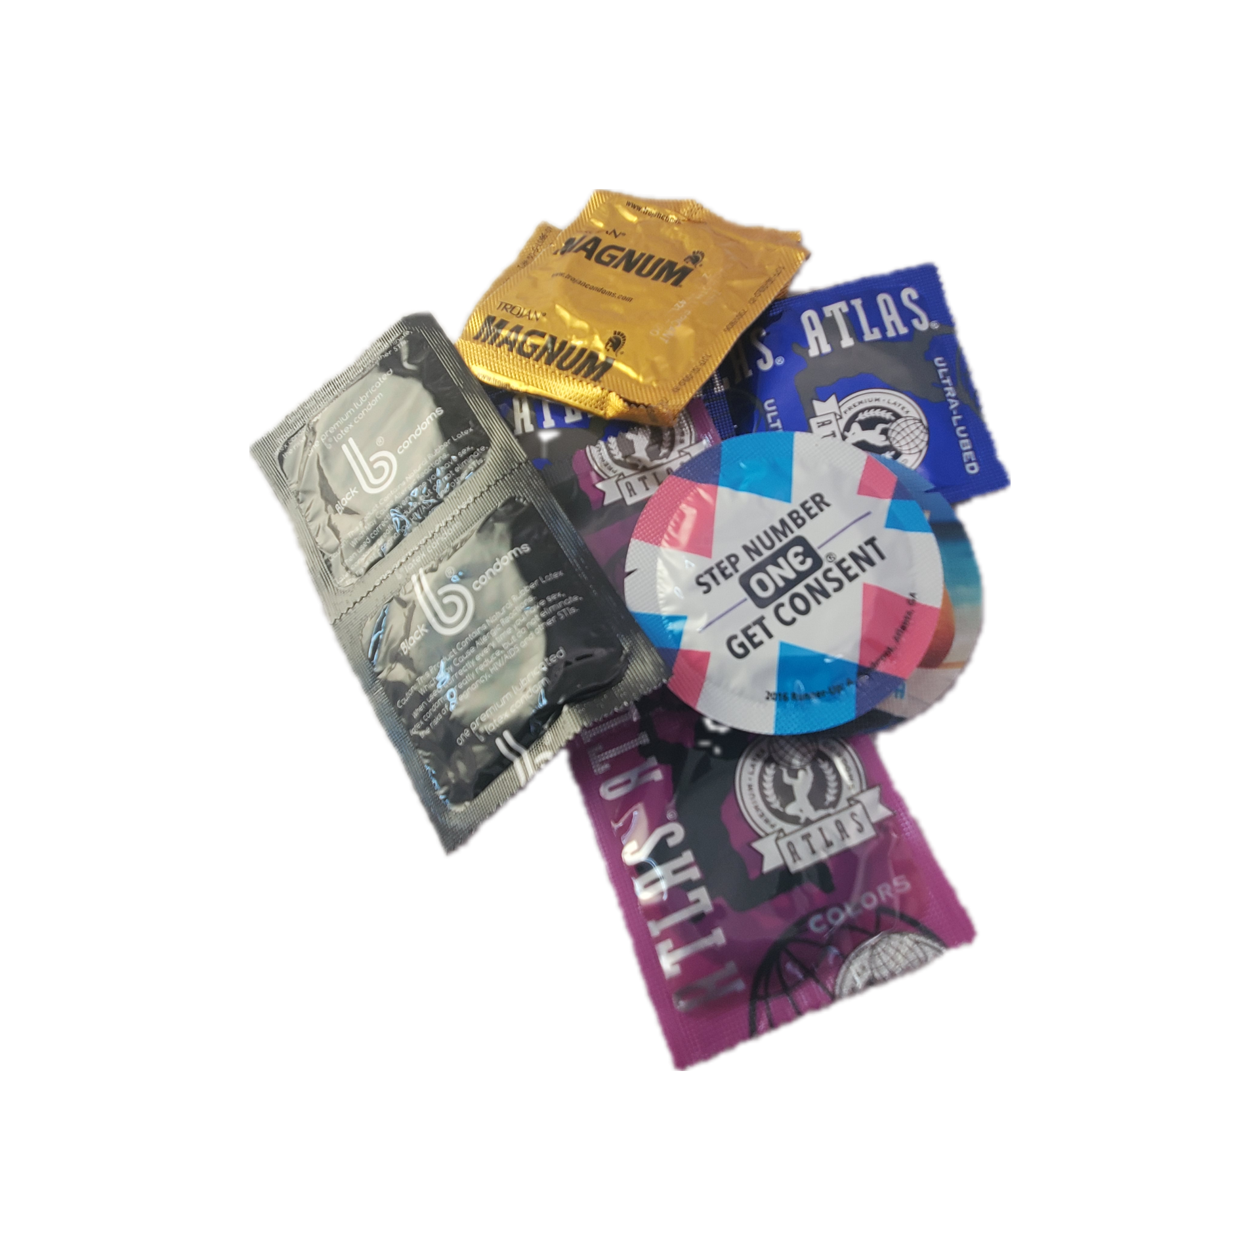
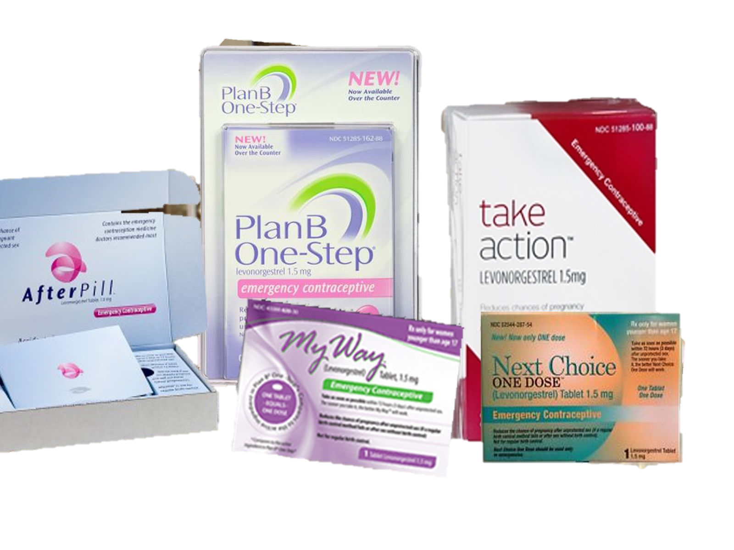
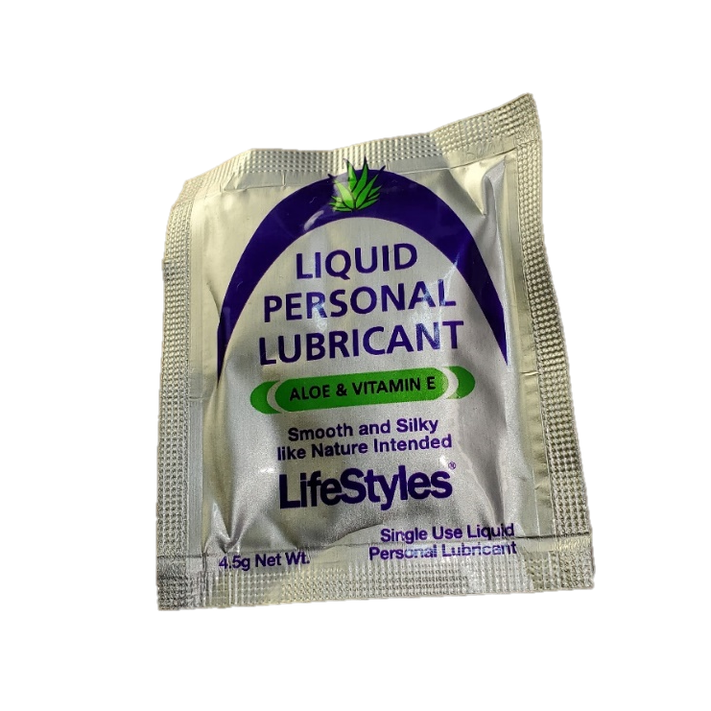
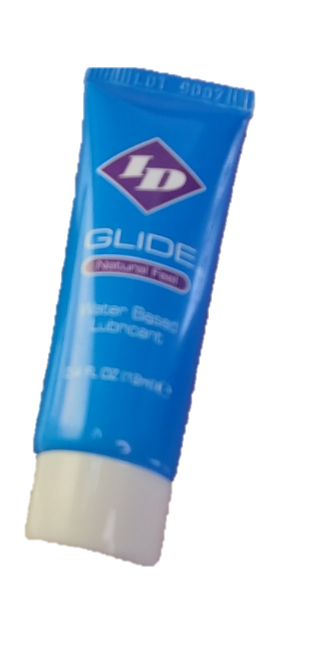
Safer Sex
Condoms and lubricant
Emergency contraception
Informational handouts
Notes:
Drugs’ effects may include increased sex drive or sexually passivity, which could lead to unprotected sex and sexual activities that increase the risk of spreading HIV and/or Hepatitis C between partners. Some drug effects decrease libido and may not be associated with increased sexual risk. An SSP is best suited to provide condoms, lube, emergency contraception, and family planning counseling on an as-needed basis. Level of knowledge and need will vary widely among participants.
Family planning helps address the vertical transmission of HIV and/or Hepatitis C from mother to baby during delivery. Emergency contraception, also known as the morning after pill, can be distributed by SSPs for participants to keep on hand in case of need because Plan B One-Step and its generics do not require a prescription.
Note: ella®, which is more suitable for people who weigh more than 155 lbs., does require a prescription, so sexual health counseling and referrals to a prescriber (some states allow people to get a prescription for ella® or other contraceptives based on telehealth and online pharmacies at low cost) with these participants is more appropriate.
Educational materials must match participant understanding and literacy - avoid talking down to participants, making assumptions, and displaying judgmental attitudes. Importantly, condoms, lube, and emergency contraception should not be forced on participants, and participants should not be coerced into family planning counseling sessions.

Slide 43
Safer Sex
STI prevention, regular STI testing, family planning, and keep emergency contraception on hand
Negotiate – if condoms are rejected, then lube helps reduce friction and tears
No sexual healthcare
Best: STI prevention, regular STI testing, family planning, and contingency planning
Keep emergency contraception on hand
OK: Negotiate – if condoms are rejected, then lube helps reduce friction and tears
Please avoid: No sexual healthcare
Avoid assuming sexual orientation
Ask participants open ended questions
Signs and flyers can start a conversation
Notes:
SSPs can help increase community access to free STI testing and treatment resources with signs, flyers, and handouts. When it is challenging to access sexual healthcare locally, provide online resources.
Since participants may face discrimination in healthcare settings, SSPs may vet the resources on their lists for how accessible the resources are. Developing partnerships with healthcare centers and providers that have experience prescribing birth control or Truvada for HIV prevention, for example, may help increase participant satisfaction with the referrals.
SSPs can distribute emergency contraception, or if not, help participants access it online with the following resources:
Participants can find charts for off label birth control pill use for emergency contraception on http://www.not-2-late.com/ which redirects to https://ec.princeton.edu/. Telemedicine platforms allow users to purchase contraception online - to begin, answer questions, answers sent to physician, if physician sees no serious risks, then they mail the contraception. Can be used to buy emergency contraception pills (highlighted sites below) or for off-label use of usual birth control pills. Find the flow chart for the questions usually asked about starting birth control here: https://www.reproductiveaccess.org/wp-content/uploads/2014/12/QuickstartAlgorithm.pdf
Note: Plan B One-Step® and its generics do not require a prescription while ella® does. ella® is appropriate for people over 150 lbs.
Afterpill.com *exists to help people keep pill on their shelves. no expedited shipping, they recommend amazon for that*
Kwikmed.com sells ella® with expedited shipping
Nurx (limited to certain States)
Project Ruby https://www.prjktruby.com/
Lemonaid Health https://www.lemonaidhealth.com/
Maven https://www.mavenclinic.com/ *pay for membership*
the Pill Club https://thepillclub.com/ *takes insurance
Info from Reproductive Health Technologies Project: http://rhtp.org/wp-content/uploads/2016/08/RHTPBuildingBridges-InnovationinTelemedicineUsefortheProvisionofReproductiveHealthCare.pdf

Slide 44
Additional Resources: Safer Sex
Sexual Health and Your Patients: A Provider’s Guide (https://nationalcoalitionforsexualhealth.org/tools/for-healthcare-providers/sexual-health-and-your-patients-a-providers-guide)
Find STD/HIV/Hep testing in your area (https://gettested.cdc.gov/)
Which tests should I get? (https://www.cdc.gov/std/prevention/screeningreccs.htm)
Notes:
Include your agency’s resources for testing and treatment or include local resource guides. Be sure to include resources that help staff or volunteers talk about sexual health in meaningful ways, find where to go to get STD testing, and what STD tests to ask for.

Slide 45
Section Four: Other Drug Routes of Administration
Notes:
Polydrug use
Most people who use drugs are not exclusive to one type of drug or drug administration. Additional supplies can be distributed at SSPs to be more inclusive of a diverse drug-using community.
In general, participants are the experts on relevant drug information and common routes of transmission in regional culture, not the staff at an SSP. However, SSPs may be seen as a hub for harm reduction information that is not yet well-distributed among some drug using communities. For example, naloxone access at SSPs may lead to widespread naloxone access among people who inject drugs, while people that snort or ingest opioids remain unaware or restricted from accessing it. It is not recommended or necessary for SSP staff to have a detailed knowledge about drugs and drug use, but some principles from anatomy, physiology, and pharmacology may help make sense of harm reduction messages and aid in developing rapport with participants.

Slide 46
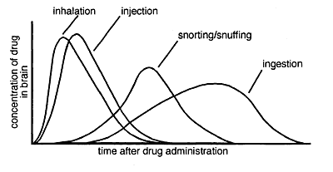
Drug Routes of Administration
Route of administration | Time Until Effect
Intravenous (IV) | 30-60 seconds
Inhalation (smoking) | 2-3 minutes
Sniffing, snorting (inhaled/ingested) | 2-90 minutes
Intramuscular (IM) | 10-20 minutes
Subcutaneous (skin popping) | 15-30 minutes
Rectal | 5-30 minutes
Ingestion | 30-90 minutes
Notes:
Here are some principles to consider:
Intravenous (IV) administration of drugs provides the most effect for a small amount of drugs and a more rapid effect than most administrations. Choosing another route is challenging for someone who is used to the economy and rush of IV use. Keep these considerations in mind when counseling participants to make changes in their drug use.
Drugs become available to the brain when in the blood. When taken orally, drugs are absorbed after passing through the stomach and parts of the intestines, areas that may break down or change the chemical composition of the drugs. When absorbed in the gut, the drugs are passed through the liver, which is responsible for metabolizing or breaking down many kinds of drugs, before entering the bloodstream. A lot of the drug is “lost” when taken orally. Pills designed to be taken orally are full of extra materials, like fillers, that help the pill keep its shape. Sometimes have mechanisms to deter tampering, like the pill turns into a sticky gel when crushed. Even a pill that is easy enough to crush for other routes of transmission can have harmful chunks that make cuts in the nasal venous plexus when snorted or, when injected, can form emboli in the blood that cause heart and brain emergencies.
Routes of administration that most rapidly get drugs into the blood include inhalation - the drugs are suspended in air and pass to the blood through the lungs - and IV injection. Since the lungs are closer to the heart than any venous injection site, the effects will be most rapid from inhalation. However, there is a lot of variability in how smoke is ingested, and once ingested, how well the lung functions to absorb it, so drugs may be lost when smoked too. Furthermore, some substances burn differently than others and require different equipment for different kinds of smoke capture. For example, heroin is smoked through a “hammer” shaped pipe or burned on a piece of foil and the smoke is inhaled through a tube, crystal meth forms a liquid, so it is smoked from a glass bulb, and crack cocaine stays mostly solid and is smoked from a glass stem.
The route of administration that most closely resembles IV use is rectal administration. The tissues in the anus change from being part of the gut - where the blood passes to the liver and drugs are broken down - to bring more like the skin. There are highly vascularized anal columns in the anus where 1mL of drugs slowly dribbled will have a large effect for a smaller, less expensive amount of drugs. Administering drugs there also provides a rush, like IV injection. Any drug that can be made into an aqueous (watery) solution can be administered rectally.
Sniffing or snorting, like rectal administration, target highly vascularized tissues in the nostrils, which have rapid effect. Some drug will be lost to postnasal drip, down the back of the throat and into the gut. However, the tissues are fragile and prone to inflammation (we’ve all had stuffy noses!), so even though this is a common and convenient route of administration, it does not work as a long term habit. Heavy use by sniffing or snorting is associated with a breakdown of the vascular plexus in the nose, so less drug can be absorbed there.
These principles provide a limited framework for understanding drug use. The broader setting will impact what drugs and routes of transmission a community or individual has access to. Consider someone who is used to snorting lines in the bathroom on a break at work. This person would not choose rectal administration instead because it requires the person to lie on their side, which is much more appropriate in a private, not public setting.

Slide 47
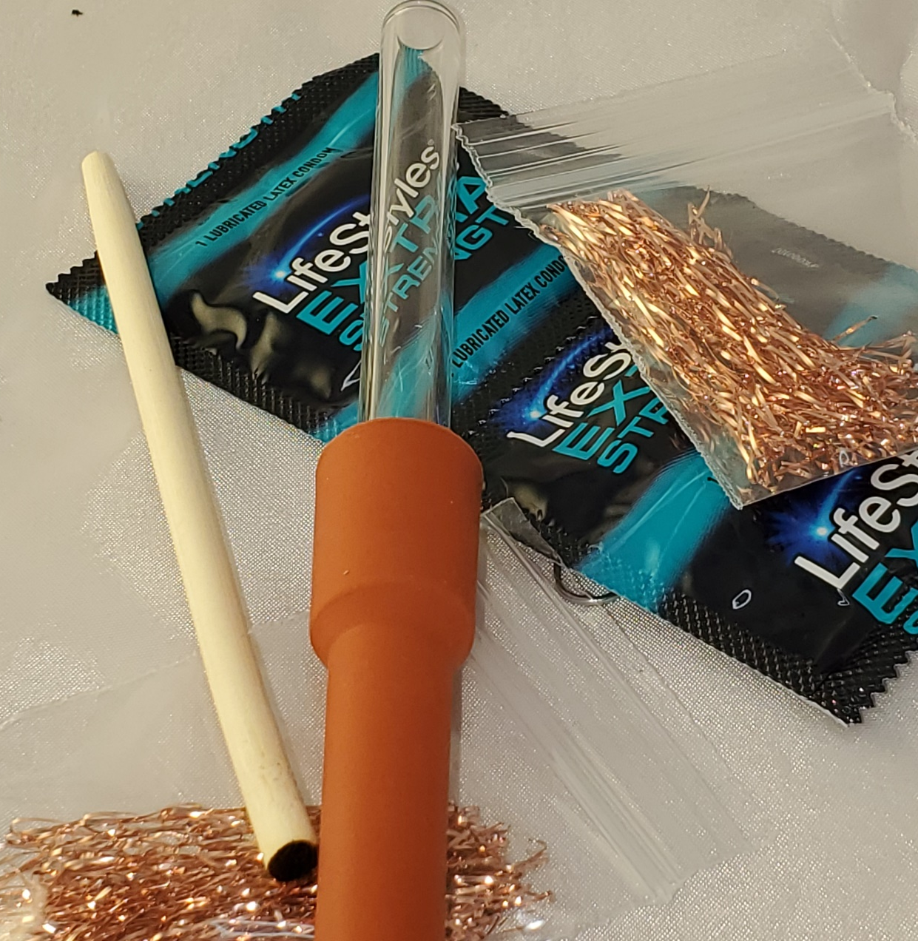
Safer Smoking Kits
For program participants that smoke their drugs, sharing pipes can spread HIV, other STIs, and tuberculosis.
Glassware
Stem
Bubbler or ball pipe
Smoke Kit
Foil Sheets
Pipe Cover
Lip Balm
Notes:
Glass Stem
Use for crack cocaine or smoking off foil. 3.8" length, 1/4" inner diameter.
Glass Bubbler or ball pipe
For smoking methamphetamine. 5" length, 1/4" inner diameter.
Smoke Kit
Contains 1 pipe cover mouth piece, 1 screen, 1 chopstick, 1 paper clip, 1 alcohol prep pad, and 1 packet antibiotic ointment.
Foil Sheets
Uncoated 100% aluminum foil; sheets measure 200 mm x 125 mm. for freebasing
Pipe Cover
Rubber or PVC tubing that acts as a mouth piece to help prevent burns to the lips and surrounding skin
Lip Balm
Helps prevent cracked, dry lips and skin around the mouth.
For program participants that smoke their drugs, sharing pipes can spread HIV, other STIs, and tuberculosis. Having open sores on the mouth or lips from overheated or broken pipes is a possible way to transmit STIs during oral sex. Distributing pipes or safer smoking kits may help reduce pipe sharing. Even if participants continue to share pipes in intimate settings, distributing these materials from an SSP may reduce instances of homemade pipes fashioned from lightbulbs that are likely to break and cause injury or burns. Pipes manufactured from Pyrex, which is less likely to break or become too hot, are better than other store bought pipes for reducing harm.
Freebasing, also known as “chasing the dragon,” is a common way of ingesting heroin in some parts of the world. Heroin is placed on foil, heated with a lighter from below, then the smoke is ingested using a glass pipe or foil tube. Some studies have shown that by offering foil, programs increase their reach in communities that may be affected by overdose but not reached by SSP-based naloxone programs. Also, injectors may change their route of transmission temporarily or permanently from injection to smoking. Although smoking comes with its own set of health risks, it is associated with fewer infections and infectious diseases than injection. The foil that is distributed by harm reduction programs is shrink-wrapped in packs of 20 or 50 and uncoated in response to concerns about store bought aluminum foil being coated with cooking oils.

Slide 48
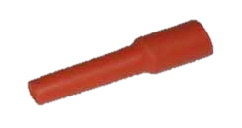
Smoking
Glassware
Mouthpiece
Best: Unbroken Pyrex pipe or glass stem, unshared
OK: Sterilize pipe with alcohol wipes or use a mouthpiece
Please Avoid: Pipes made of plastic, pop cans or copper
Best: Rubber or plastic mouthpiece
OK: rubber bands, tape or an empty cardboard matchbook
Notes:
Pipes made of plastic, pop cans or copper add to the dangers of smoking crack by releasing toxic fumes when heated or burned. Thin glass pipes, such as light bulbs or syringes, break easily and can lead to cuts.
Rubber or plastic mouthpiece attached at the mouth end of the pipe prevents burns. Mouthpieces can differ in length and width to be the best fit for a stem.

Slide 49
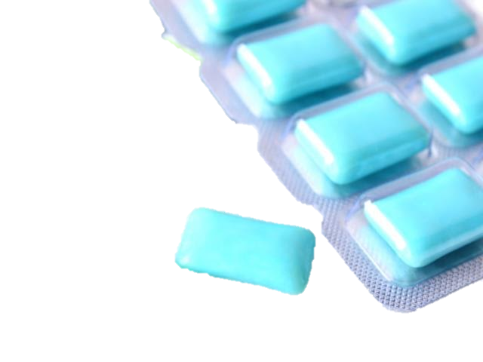
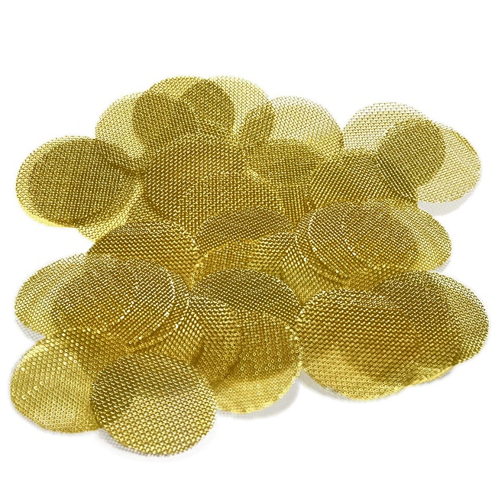
Smoking: Safer Smoking Kits
Push sticks
Other Materials for Safer Smoking
Best: Wooden (such as chopsticks or kebob sticks)
Please avoid: Metal or plastic pushers
Alcohol swabs and hand
Lighters
Chewing gum
Condoms and lube
Notes:
Metal pushers (such as a coat hanger or screwdriver) can chip or cause cracks in the glass stem, which can cause oral sores. Plastic pushers (such as a pen or syringe) can melt inside the pipe.
Alcohol swabs and hand wipes for cleaning one’s hands and equipment before using the equipment. This prevents bacteria and germs in the environment from getting into the body.
Lighters, so every individual can apply consistent heat to their own pipe. The lack of one’s own heat source increases the chance that a person will share a pipe with someone else.
Chewing gum, to prevent lockjaw and keep the mouth hydrated.
Safer-sex education may be appropriate alongside safer drug-use education.

Slide 50
Rectal
“Booty Bumping Vacation, ” also known as Boofing or Plugging
Use syringe barrel with a removable needle that is removed
Draw up 1mL of aqueous drug solution
Remove needle, put a little lube on the tip of syringe barrel, insert into anus (about 4cm), and slowly push the plunger (no less than 3 seconds from start to finish)
Drugs “dribble” and absorb in the highly vascular “anal columns,” which provides a very rapid effect
Notes:
If someone is used to 100% drug absorption with IV injection, then drug administration in the rectum is closest. There may not be the same rush, but this is close. More of the drugs are available in the bloodstream than if the same amount were snorted. If transitioning from snorting to rectal, decrease the usual dose.

Slide 51
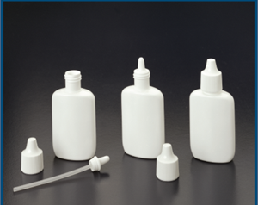
Nasal: Spray
Prepare drugs in a solution, the same way as injection
Put into a cleaned handheld squeeze bottle (like a recycled Afrin squeeze bottle)
Add some water
Less diluting means fewer pumps to get a high
Thoroughly clean or get a new bottle every two days
If keep longer, can grow bacteria or brain-eating amoebas – very dangerous!
Notes:
The nose contains a full vascular plexus that provides a straight path into the bloodstream. Intranasal administration is most efficient using a spray, which maximizes spread of the drug over the vascular plexus.

Slide 52
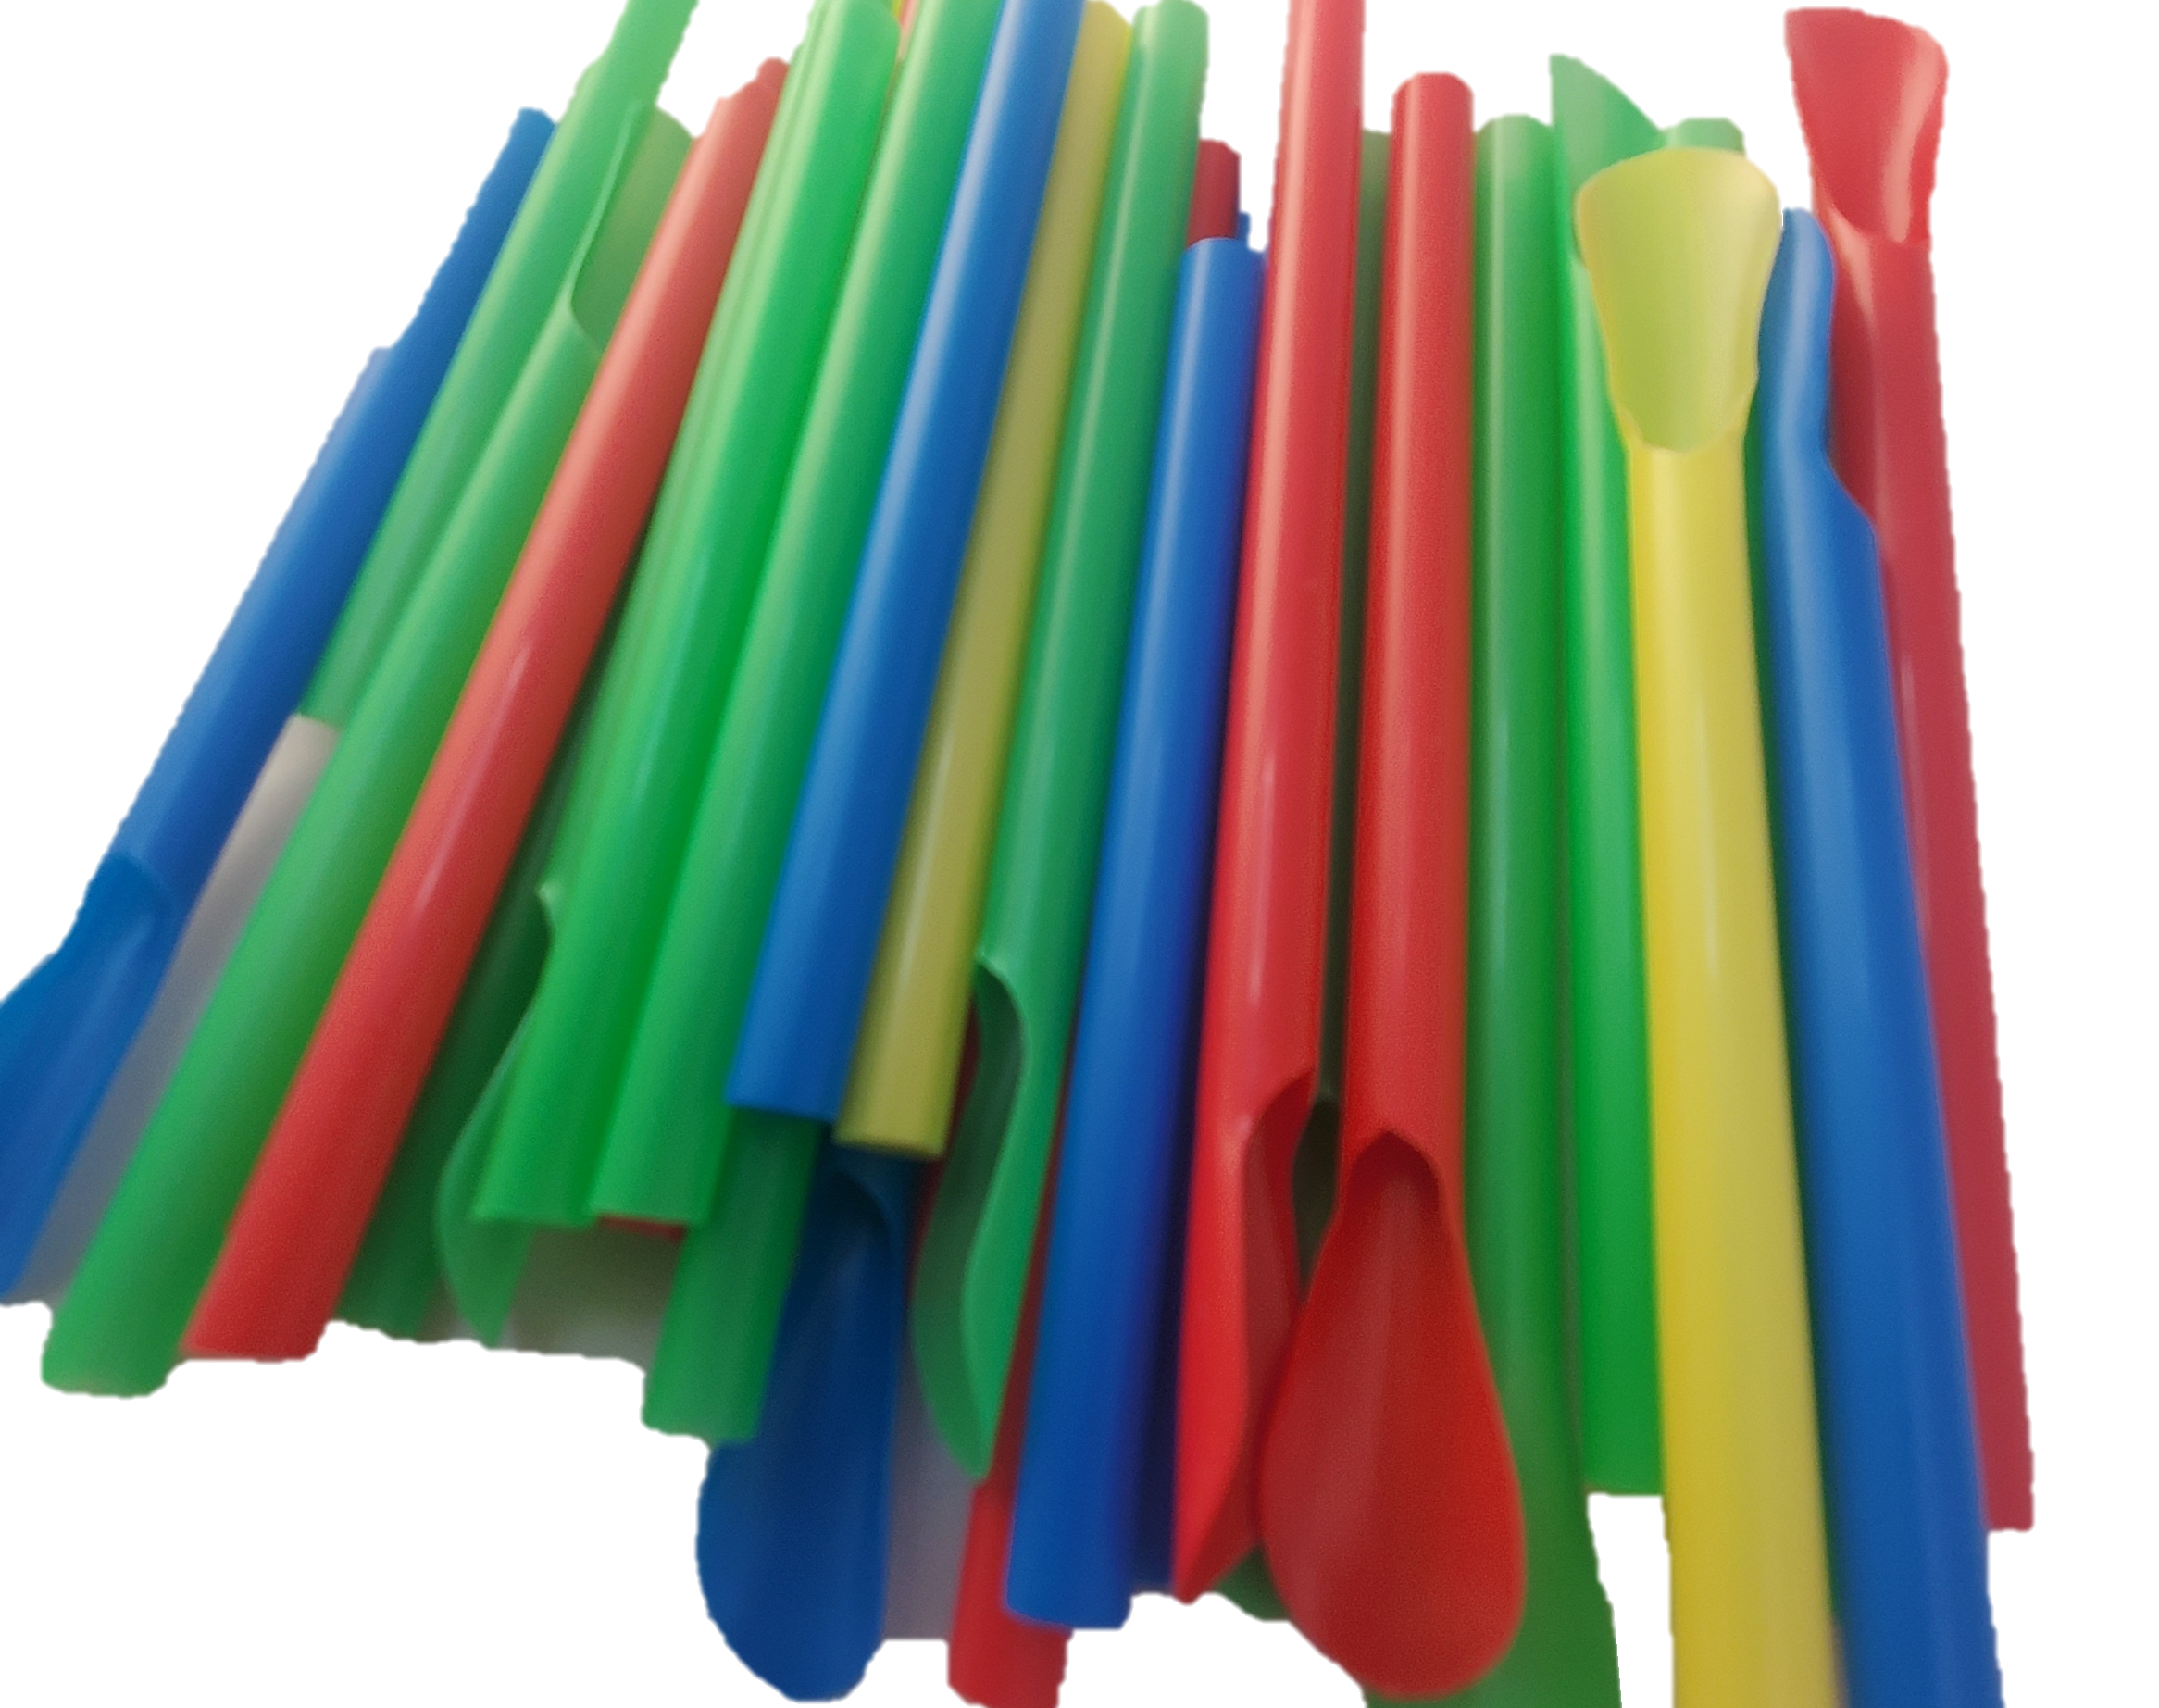
Nasal: Sniffing
Bacteria and viral hepatitis may be present on
Scoops – often a straw or key used to remove a small amount of powder from a bag
Surfaces used to break up particles in the powder
Straws (or rolled up dollars) used for sniffing
Safer sniffing kits may include:
Sniffing straws
Sticky Notes
Sniffing sterile water/saline strips
Chewing Gum
Notes:
Notes:
Used sniffing straws (or rolled up dollars) can carry bacteria and Hepatitis C. An unhygienic straw or key used to scoop small doses from a larger supply introduces bacteria and viruses to the drug supply itself
The safest way to snort is to use a sterile straw or piece of paper every time, then throw it out. If reusing, reduce (but not eliminate) risk by avoiding sharing.
Straws with scoops on the end are great for taking “bumps” and can also be used to break up particles in powder drugs
If sniffing with friends, color code whose straw is whose.
Straws
Bacteria and viral hepatitis may be present on
Scoops – often a straw or key used to remove a small amount of powder from a bag
Surfaces used to break up particles in the powder
Straws (or rolled up dollars) used for sniffing
Straws with scoops on the end (slushy straws) are good tools to distribute because
Double function: scoop and straw
Many colors, for avoiding sharing
Best: New straw every time
OK: Sterilize straw with alcohol wipes
Please Avoid: Sharing or reusing straws – bacteria grow quickly, HCV sticks around, and there are lots of blood vessels in your nose
Sticky note
Best: Use a sticky note (ex. Post-It) for snorting lines with, or to snort drugs off of
OK: Sterilize the surface used to sniff off of
Please Avoid: Using dollar bills to sniff with, which collect bacteria and viruses
Water
Best: Sniffing sterile water/saline strips (Addipaks) before and after a session of drug use will help protect skin.
Good for general health
Reduces chance of having openings where germs can enter
OK: Tap water, sealed bottled water, boil water for 30 mins
Opened bottles of water, water from back of toilet
Please Avoid: Water from front of toilet, puddle/gutter water
Chewing Gum
Helps increase saliva
Saliva protects the enamel on teeth
Chewing reduces the risk of teeth grinding

Slide 53
Additional Resources
Workforce Safety for Syringe Service Programs by AIDS United (https://www.aidsunited.org/resources/workforce-safety-for-syringe-service-programs)
Chicago Recovery Alliance’s Better Vein Care/Safer Injection Guide (https://anypositivechange.org/wp-content/uploads/BVCSI_all.pdf)
Harm Reduction Coalition’s Getting off right: A safety manual for injection drug users (https://harmreduction.org/issues/safer-drug-use/injection-safety-manual/).
Methamphetazine: A Harm Reduction Guide (https://harmreduction.org/issues/safer-drug-use/injection-safety-manual/)
AIDS United’s The Right Hit section on “syringe litter” (https://www.aidsunited.org/resources/therighthit )
Safeneedledisposal.org – helps spread public information about legal disposal practices, which vary from state to state.
Naloxone resources: Naloxoneforall.org and Prescribetoprevent.org
Notes:
This overview by no means takes the place of a thorough education in safer injection and better vein care practices. The best information may come from participants, who know the local setting and environments and how to adapt to survive them.

